Slide 1
Unit 2: Basic Computer Architecture Unit 4: Assembly Language Programming

Slide 2
8085 Microprocessor & Assembly Language Programming with 8085
PART-I

Slide 3
Introduction to 8085 Microprocessor
Intel 8085A (simply 8085) is an 8-bit general-purpose microprocessor introduced by intel in 1977.
It can address 64K Byte of memory.
It has 40 pins.
An 8085 Microprocessor requires a +5V power supply to operate.
Its clock speed is about 3 MHz.
Intel 8085 is an enhanced version of Intel 8080.

Slide 4
Important Features of 8085
BUS:
A bus is a collection of lines, which carries data or programs and perform some logical tasks.
The size of a bus indicates the number of lines in it, and hence the number of bits the bus can carry – as one line carries one bit of information.
There are three types of buses:
Address bus:
This bus carries the address of a particular location, for a transfer.
It is unidirectional.
16-bit address bus, which can address up to 64KB.
It is very important to know that the size of the address bus decides the maximum number of locations the processor can address.
i.e. n-bit address bus 2^{n} memory locations.
The memory address range is from 0000H … FFFFH.

Slide 5
Important Features of 8085
BUS:
Data Bus:
This bus carries the data to be transferred. It is bidirectional.
8085 has an 8-bit data bus, which means it can transfer 8-bits in one operation and hence it is called as an 8-bit microprocessor.
Control Bus:
This bus carries the control signals that would cause any kind of an operation. The basic control signals are RD, WR etc.
Together these three buses are called as the SYSTEM BUS.
This microprocessor is an 8-bit device that receives, operates, or outputs 8-bitinformation in a simultaneous approach.
It can generate 8-bit IO Address hence it can access 2⁸ I/O Ports i.e. 256 I/O Ports. The I/O Address ranges from 00H … FFH.
This is constructed of a single NMOS chip device and has 6200 transistors.

Slide 6
Important Features of 8085
This microprocessor is available in a DIP package of 40 pins.
A 16-bit program counter
A 16-bit stack pointer
Six 8-bit general purpose registers arranged in pairs:
BC, DE, HL
It works on +5 V power supply.
Its operating frequency is 3 MHz
A total of 246 operational codes and 74 different instructions are present.
It accepts 5 external hardware interrupts i.e., TRAP, RST 7.5, RST 6.5, RST 5.5 and INTR.
The 8085 microprocessor has eight software interrupts from RST0 through RST7.

Slide 7
Internal Architecture of 8-bit Microprocessor and its Registers
The Intel 8085A is a complete 8-bit parallel central processing unit.
The main components of 8085A are array of registers, the arithmetic logic unit, the encoder/decoder, and timing and control circuits linked by an internal data bus.
The block diagram is shown below:

Slide 8
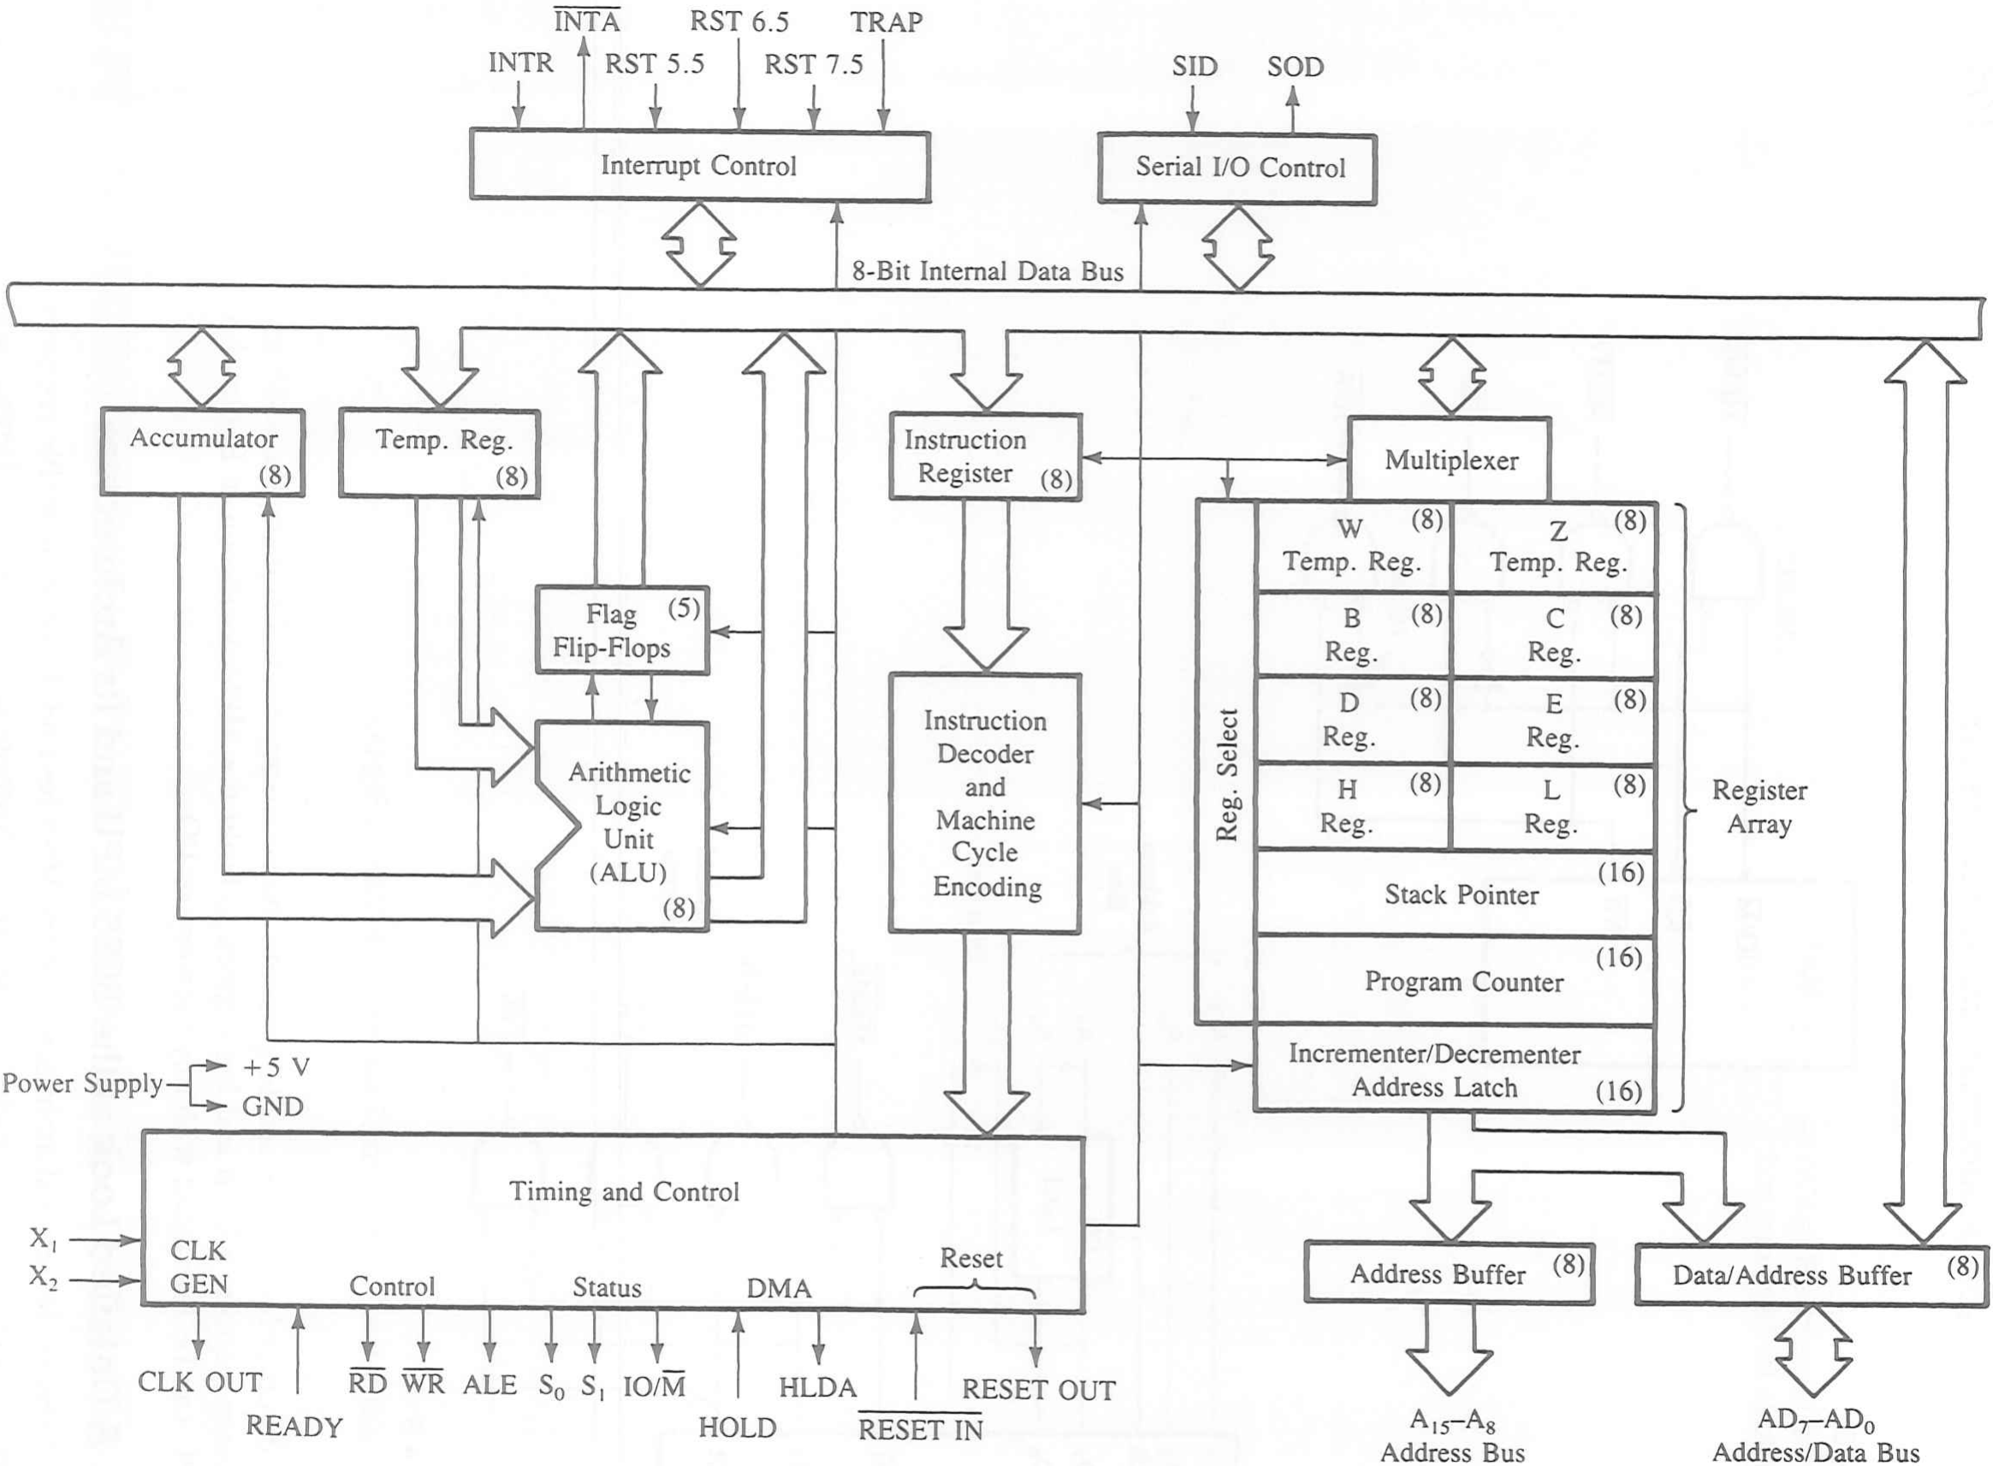
8085 Functional Block Diagram (Internal Architecture)

Slide 9
1. Registers
Program Counter (PC, 16-bits):
It is a 16-bit Special-Purpose register. It holds address of the next instruction. PC is incremented by the INR/DCR after every instruction byte is fetched.
Stack Pointer (SP, 16-bits):
It is a 16-bit Special-Purpose register. It holds address of the top of the Stack.
Stack is a set of memory locations operating in LIFO manner.
SP is decremented on every PUSH operation and incremented on every POP.
B, C, D, E, H, L registers 8-bits each:
These are 8-bit General-Purpose registers.
They can also be used to store 16-bit data in register pairs.
The possible register pairs are BC pair, DE pair and pair.
The HL pair also holds the address for the Memory Pointer "M".
Temporary Registers (WZ, 16-bits):
This is a 16-bit register pair.
It is used by μP to hold temporary values in some instructions like XCHG,CALL/JMP etc. The programmer has no access to this register pair.

Slide 10
1. Registers
INR/DCR Register (16-bits):
This is a 16-bit shift register.
It is used to increment PC after every instruction byte is fetched and increment or decrement SP after a Pop or a Push operation respectively.
It is not available to the programmer.
A - Accumulator (8-bits):
It is an 8-bit programmable register.
The user can read or write this register.
It has two special properties:
It holds one of the operands during most of the arithmetic operations.
It holds the result of most of the arithmetic and logic operations.
Temp Register (8-bits):
This is an 8-bit register.
It is used by μP for storing one of the operands during an operation.
The programmer has NO ACCESS to this register.

Slide 11
2. FLAG REGISTER
Register consists of five flip flops, each holding the status of different states separately is known as flag register and each flip flops are called flags.
8085A can set or reset one or more of the flags and they are:
Sign(S),
Zero (Z),
Auxiliary Carry (AC)
Parity (P) and
Carry (CY).
The state of flags indicates the result of arithmetic and logical operations, which in turn can be used for decision making processes.
The different flags are described as:

Slide 12
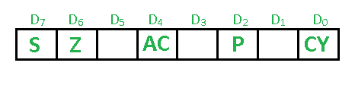
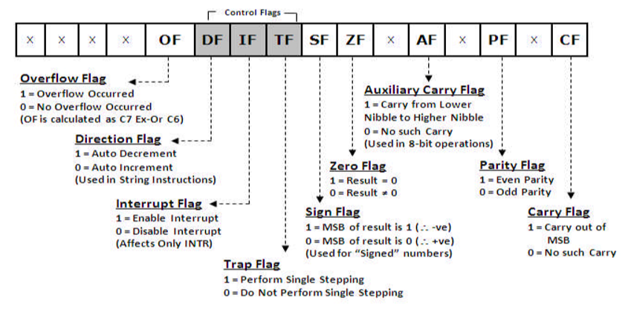
2. FLAG REGISTER

Slide 13
2. FLAG REGISTER
S - Sign Flag:
It is set (1) when MSB of the result is 1 (i.e. result is a -VE number).
It is reset (0) when MSB of the result is 0 (i.e. result is a +VE number).
Z - Zero Flag:
It is set when the result is = zero.
It is reset when the result is not = zero.
AC - Auxiliary Carry Flag:
It is set when an Auxiliary Carry / Borrow is generated.
It is reset when an Auxiliary Carry / Borrow is not generated.
Auxiliary Carry is the Carry generated between the lower nibble and the higher nibble for an 8bit operation. It is not affected after a 16- bit operation. It is used only in DAA operation.
P - Parity Flag:
It is set (1) when result has even parity. It is reset when result has odd parity.
C - Carry Flag:
It is set when a Carry / Borrow is generated from the MSB.
It is reset when a Carry / Borrow is not generated from the MSB.

Slide 14
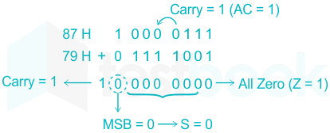
2. FLAG REGISTER
Example of Flag:

Slide 15
3. TIMING AND CONTROL UNIT
This unit synchronizes all the microprocessor operations with the clock and generates the control signals necessary for communication between the microprocessor and peripherals.
The timing and control circuit issues the various internal and external control signals for executing and instruction.
The signals are sync pulses indicating the availability of data on the data bus.

Slide 16
4. INTERRUPT CONTROLS
The various interrupt control signals (INTR, RST 5.5, RST 6.5, RST 7.5 and TRAP) are used to interrupt a microprocessor.

Slide 17
5. SERIAL CONTROL
This Block is responsible for transferring data Serially to and from the μP.
SID - Serial In Data:
μP receives data, bit-by-bit through this line.
SOD - Serial Out Data:
μP sends out data, bit-by-bit through this line.
Serial transmission can be done by RIM (Read Interrupt Mask) and SIM (Set Interrupt Mask) Instructions.

Slide 18
6. ALU – ARITHMETIC LOGIC UNIT
8085 has an 8-bit ALU.
It performs 8-bit arithmetic operations like Addition and Subtraction.
It also performs logical operations like AND, OR, EX-OR NOT etc.
It takes input from the Accumulator and the Temp register.
The output of most of the ALU operations is stored back into the Accumulator.

Slide 19
7. INSTRUCTION REGISTER AND DECODER
Instruction Register:
The 8085 places the contents of the PC onto the Address bus and fetches the instruction. This fetched instruction is stored into the Instruction register.
Instruction Decoder:
The fetched instruction from the Instruction register enters the Instruction Decoder.
Here the instruction is decoded and the decoded information is given to the Timing and Control Circuit where the instruction is executed.
Note: “Programmer’s Model” simply means all registers in the architecture that are available to the programmer. So if they ask Programmers model, draw the internal part of the architecture without the pins, and explain all registers.
Instruction Register:
The 8085 places the contents of the PC onto the Address bus and fetches the instruction. This fetched instruction is stored into the Instruction register.
Instruction Decoder:
The fetched instruction from the Instruction register enters the Instruction Decoder.
Here the instruction is decoded and the decoded information is given to the Timing and Control Circuit where the instruction is executed.
Note: “Programmer’s Model” simply means all registers in the architecture that are available to the programmer. So if they ask Programmers model, draw the internal part of the architecture without the pins, and explain all registers.

Slide 20
HOW DOES MICROPROCESSOR WORK?
The instructions are stored sequentially in the memory.
The microprocessor fetches the first instruction from its memory sheet, decodes it and executes that instruction.
The sequence of fetch, decode, and execute is continued until the microprocessor comes across an instruction to stop.
During the entire process, the microprocessor uses the system bus to fetch the binary instructions and data from the memory.
It uses register from the register section to store data temporarily and it performs computing function in arithmetic logic unit [ALU] section.
Finally, it sends out the result in binary using the same bus lines.

Slide 21
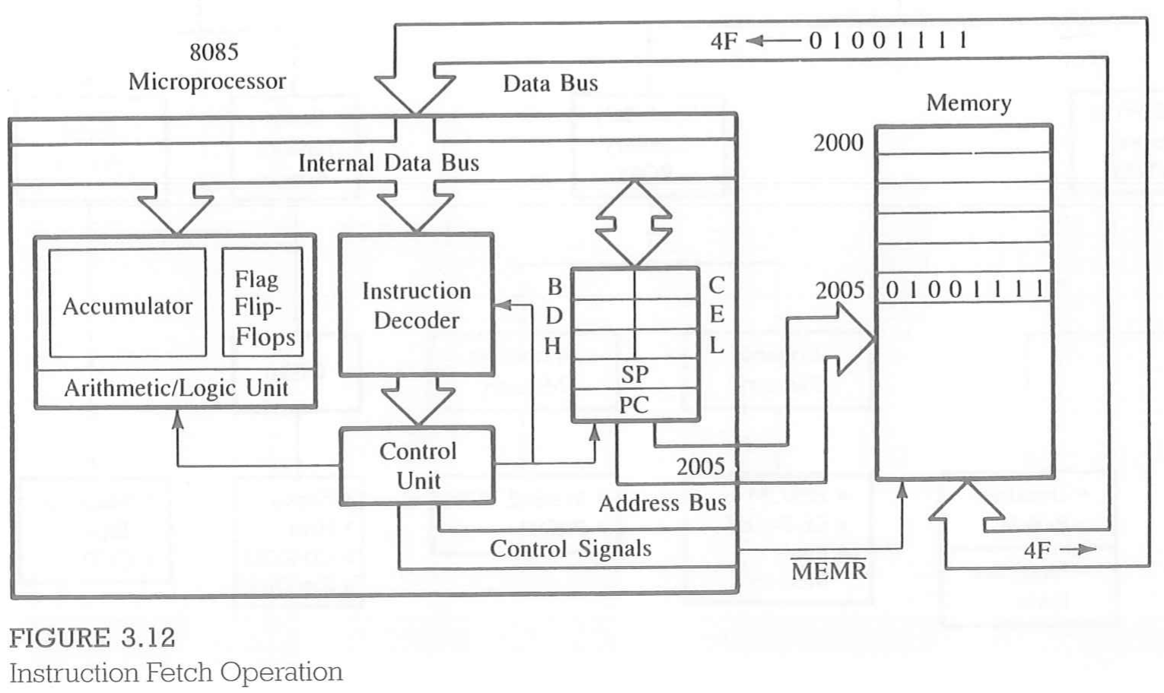
Memory and Instruction Fetch
The primary function of memory is to store instructions and data and to provide that information to MPU whenever the MPU requests it.
The MPU requests the information by sending the information of a specific memory register on the address bus and enables the data flow by sending the control signal, as illustrated in the following example.

Slide 22
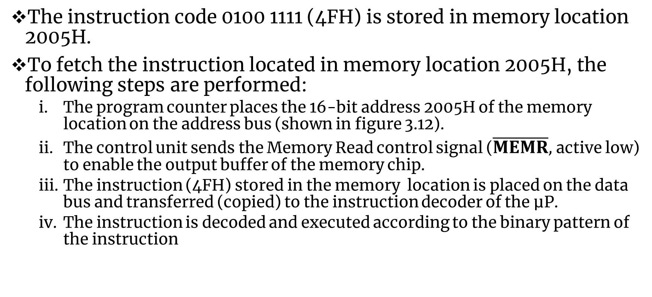
Memory and Instruction Fetch
The instruction code 0100 1111 (4FH) is stored in memory location 2005H.
To fetch the instruction located in memory location 2005H, the following steps are performed:
The program counter places the 16-bit address 2005H of the memory location on the address bus (shown in figure 3.12).
The control unit sends the Memory Read control signal ($\overline{MEMR},$ active low) to enable the output buffer of the memory chip.
The instruction (4FH) stored in the memory location is placed on the data bus and transferred (copied) to the instruction decoder of the µP.
The instruction is decoded and executed according to the binary pattern of the instruction

Slide 23
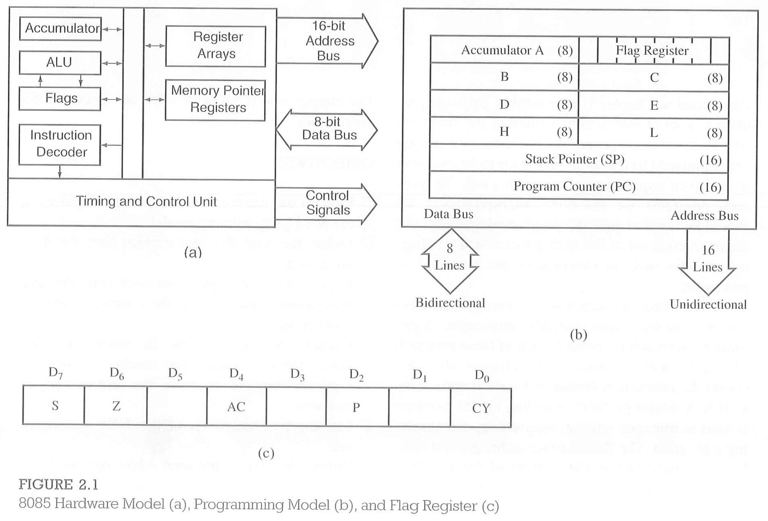
THE 8085 HARDWARE/PROGRAMMING MODEL AND FLAG REGISTERS

Slide 24
8085 HARDWARE MODEL
The hardware model in figure 2.1(a) shows two major segments.
One segment includes arithmetic logic unit [ALU] and an 8-bit register called an accumulator, instruction decoder, and flags.
The second segment shows 8-bit and 16-bit registers.
Both segments are connected with various internal connections called an internal bus.
The arithmetic and logic operations are performed in the arithmetic logic unit [ALU]. Results are stored in the accumulator, and flip-flops, called flags, are set or reset to reflect the results.
There are 3 buses: a 16-bit unidirectional address bus used to send out memory address, an 8-bit bidirectional data bus used to transfer data, and a control bus used for timing signals.

Slide 25
8085 PROGRAMMING MODEL
The programming model consists of some segments of ALU and the registers.
This model includes six registers, one accumulator, and one flag register, as shown in figure 2.1(b).
In addition, it has two 16-bit registers: the stack pointer and the program counter.
REGISTERS:
The 8085 has six general-purpose registers to store 8-bit data; these are identified as B,C,D,E,H, and L as shown in the figure 2.1(b).
They can be combined as register pairs - BC, DE, and HL - to perform some 16-bit operations.
The programmer can use these registers to store or copy data into the registers by using data copy instructions.

Slide 26
8085 PROGRAMMING MODEL
ACCUMULATOR:
The accumulator is an 8-bit register that is a part of arithmetic/logic unit (ALU).
This register is used to store 8-bit data and to perform arithmetic and logical operations. The result of an operation is stored in the accumulator.
The accumulator is also identified as register A.
FLAGS:
The ALU includes five flip-flops, which are set or reset after an operation according to data conditions of the result in the accumulator and other registers.
They are called Zero(Z), Carry (CY), Sign (S), Parity (P), and Auxiliary Carry (AC) flags; their bit positions in the flag register are shown in the Figure 2.1(c).
The most commonly used flags are Zero, Carry, and Sign.
The µP uses these flags to test data conditions.

Slide 27
8085 PROGRAMMING MODEL
FLAGS:
For example, after an addition of two numbers,
if the sum in the accumulator is larger than eight bits, the flip-flop uses to indicate a carry -- called the Carry flag (CY) -- is set to one(High).
When an arithmetic operation results in zero, the flip-flop called the Zero(Z) flag is set to one.
The first Figure shows an 8-bit register, called the flag register, adjacent to the accumulator. However, it is not used as a register; five bit positions out of eight are used to store the outputs of the five flip-flops.
The flags are stored in the 8-bit register so that the programmer can examine these flags (data conditions) by accessing the register through an instruction.
These flags have critical importance in the decision-making process of the microprocessor.
The conditions (set or reset) of the flags are tested through the software instructions.
For example, the instruction JC (Jump on Carry) is implemented to change the sequence of a program when CY flag is set.
The thorough understanding of flag is essential in writing assembly language programs.

Slide 28
8085 PROGRAMMING MODEL
PROGRAM COUNTER (PC):
This is a 16-bit register used to hold memory address.
The size of PC register is 16 bits because the memory address are 16 bits.
The microprocessor uses PC register to sequence the execution of the instructions.
The function of the program counter is to point to the memory address from which the next byte is to be fetched.
When a byte (machine code) is being fetched, the program counter is incremented by one to point to the next memory location.
STACK POINTER (SP):
The stack pointer is also a 16-bit register used as a memory pointer.
It points to a memory location in R/W memory, called the stack.
The beginning of the stack is defined by loading 16-bit address in the stack pointer.
This programming model will be used to examine how these registers are affected after the execution of an instruction.

Slide 29
Pin Diagram (Pin Configuration) of 8085
The 8085 pin diagram consists of 40 pins of the microprocessor.
The all of the signals associated with 8085 can be classified into 6 groups:
Address Bus
Data Bus
Control and Status Signals
Power Supply and Frequency Signals
Externally Initiated Signals
Serial I/O Ports

Slide 30
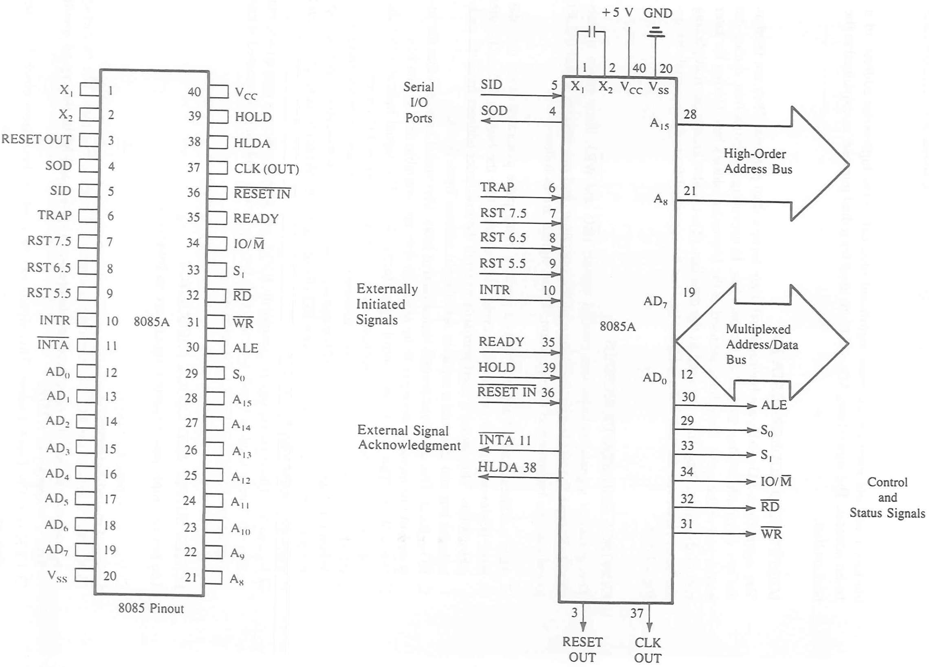
Pin Configuration of 8085

Slide 31
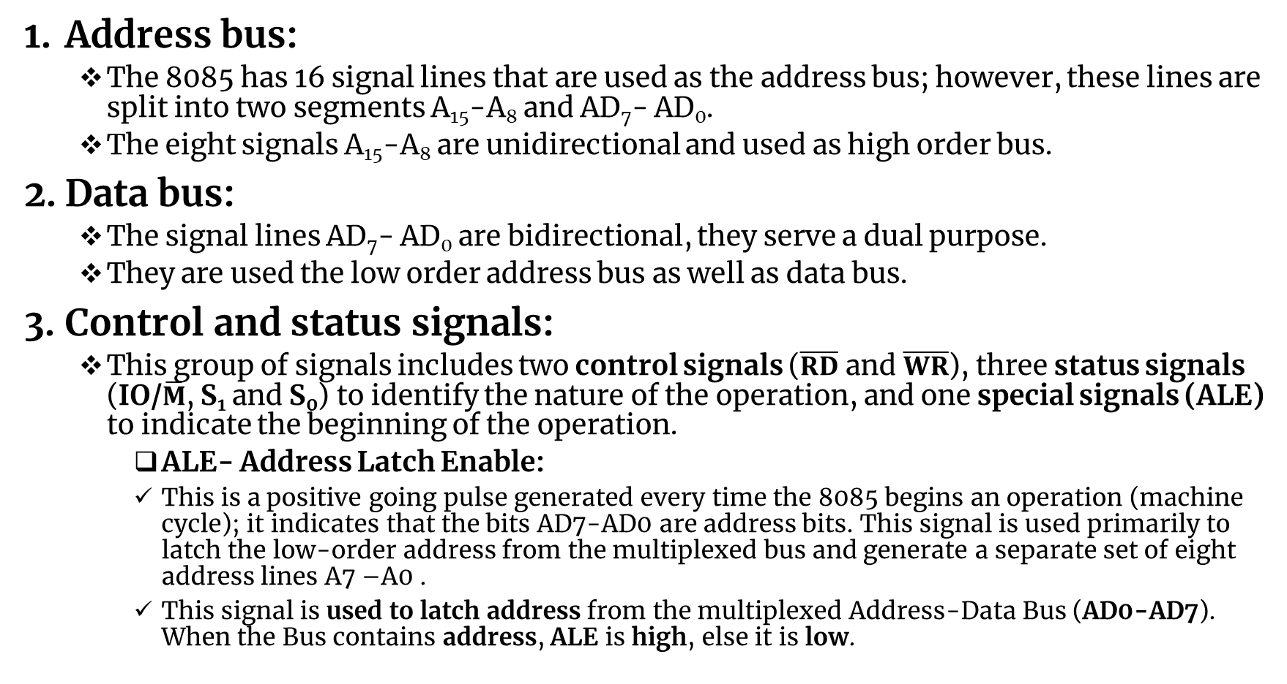
Pin Diagram (Pin Configuration) of 8085
Address bus:
The 8085 has 16 signal lines that are used as the address bus; however, these lines are split into two segments A₁₅-A₈ and AD₇- AD₀.
The eight signals A₁₅-A₈ are unidirectional and used as high order bus.
Data bus:
The signal lines AD₇- AD₀ are bidirectional, they serve a dual purpose.
They are used the low order address bus as well as data bus.
Control and status signals:
This group of signals includes two control signals ($\overline{RD}$ and $\overline{WR}$), three status signals (IO/$\overline{M}$, S₁ and S₀) to identify the nature of the operation, and one special signals (ALE) to indicate the beginning of the operation.
ALE- Address Latch Enable:
This is a positive going pulse generated every time the 8085 begins an operation (machine cycle); it indicates that the bits AD7-AD0 are address bits. This signal is used primarily to latch the low-order address from the multiplexed bus and generate a separate set of eight address lines A7 –A0 .
This signal is used to latch address from the multiplexed Address-Data Bus (AD0-AD7). When the Bus contains address, ALE is high, else it is low.

Slide 32
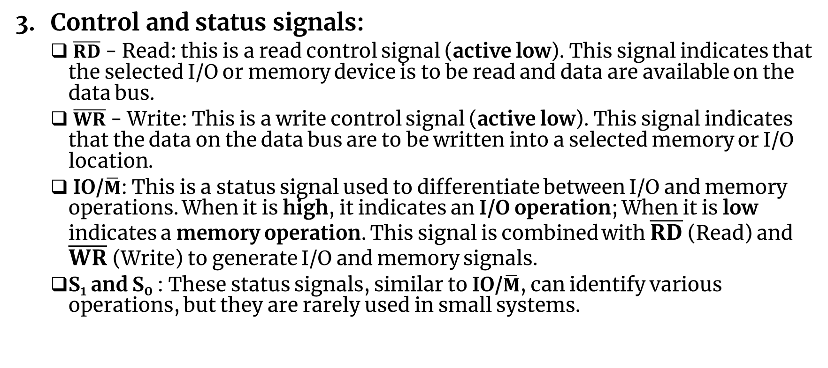
Pin Diagram (Pin Configuration) of 8085
Control and status signals:
$\overline{RD}$ - Read: this is a read control signal (active low). This signal indicates that the selected I/O or memory device is to be read and data are available on the data bus.
$\overline{WR}$ - Write: This is a write control signal (active low). This signal indicates that the data on the data bus are to be written into a selected memory or I/O location.
IO/$\overline{M}$: This is a status signal used to differentiate between I/O and memory operations. When it is high, it indicates an I/O operation; When it is low indicates a memory operation. This signal is combined with $\overline{RD}$ (Read) and $\overline{WR}$(Write) to generate I/O and memory signals.
S₁ and S₀ : These status signals, similar to IO/$\overline{M}$, can identify various operations, but they are rarely used in small systems.

Slide 33
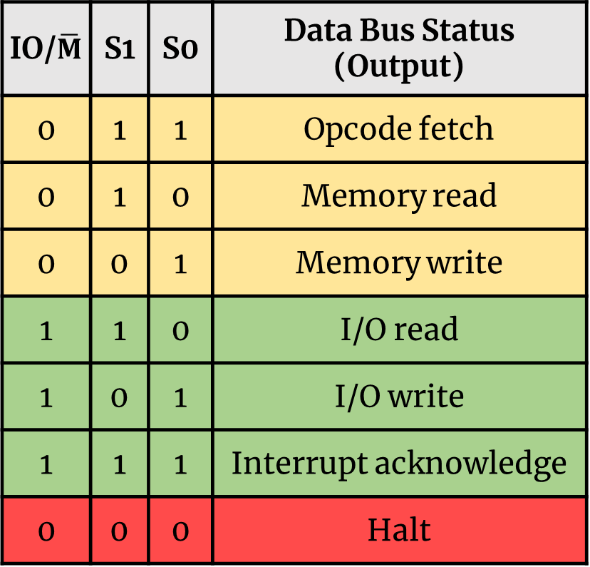
Pin Diagram (Pin Configuration) of 8085
Control and status signals:
These lines denote the status of the μP
IO/$\overline{M}$ | S1 | S0 | Data Bus Status (Output)
0 | 1 | 1 | Opcode fetch
0 | 1 | 0 | Memory read
0 | 0 | 1 | Memory write
1 | 1 | 0 | I/O read
1 | 0 | 1 | I/O write
1 | 1 | 1 | Interrupt acknowledge
0 | 0 | 0 | Halt
S1 | S0 | Status/ Operation
0 | 0 | Halt/Idle
0 | 1 | Write
1 | 0 | Read
1 | 1 | Opcode fetch

Slide 34
Pin Diagram (Pin Configuration) of 8085
Power Supply and Clock frequency:
V_{CC}: +5V power supply
V_{SS}: Ground reference
X₁, X₂:
A crystal (RC, LC Network) is connected at these two pins and is used to provide the Clock Input to the μP.
This frequency is internally divided by 2.
To operate a system at 3 MHz, the crystal oscillator should have a frequency of 6 MHz.
CLK OUT:
It can be used as the system clock for other devices.
8085 provides the Clock input to all other peripherals through the Clock Out pin.
This takes care of synchronizing all peripherals with 8085.
Its frequency is half the oscillator frequency.
Notes:
A tuned circuit like LC, RC or crystal is connected at these two pins. The internal clock generator divides oscillator frequency by 2, therefore, to operate a system at 3 MHz, the crystal of tuned circuit must have a frequency of 6 MHz.

Slide 35
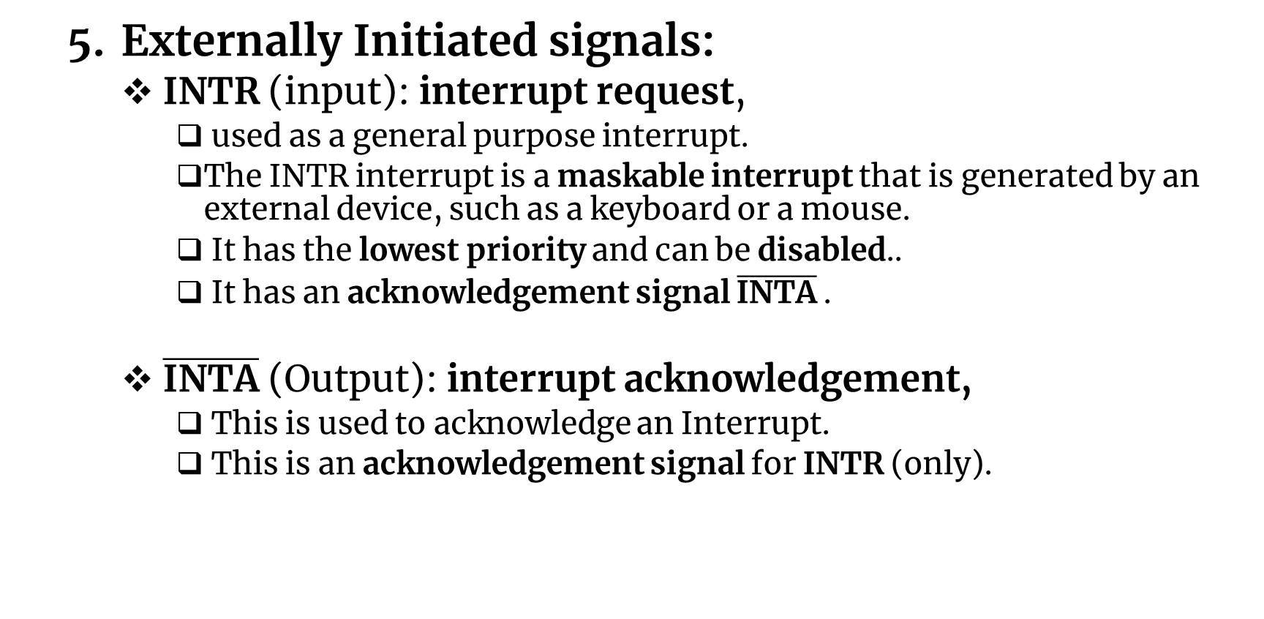
Pin Diagram (Pin Configuration) of 8085
Externally Initiated signals:
INTR (input): interrupt request,
used as a general purpose interrupt.
The INTR interrupt is a maskable interrupt that is generated by an external device, such as a keyboard or a mouse.
It has the lowest priority and can be disabled..
It has an acknowledgement signal $\overline{\text{INTA}}$ .
$\overline{\text{INTA}}$ (Output): interrupt acknowledgement,
This is used to acknowledge an Interrupt.
This is an acknowledgement signal for INTR (only).
Notes:
When microprocessor receives any interrupt signal from peripheral(s) which are requesting its services, it stops its current execution and program control is transferred to a sub-routine by generating CALL signal and after executing sub-routine by generating RET signal again program control is transferred to main program from where it had stopped. When microprocessor receives interrupt signals, it sends an acknowledgement (INTA) to the peripheral which is requesting for its service. Interrupts can be classified into various categories based on different parameters:
Hardware and Software Interrupts – When microprocessors receive interrupt signals through pins (hardware) of microprocessor, they are known as Hardware Interrupts. There are 5 Hardware Interrupts in 8085 microprocessor. They are – INTR, RST 7.5, RST 6.5, RST 5.5, TRAP Software Interrupts are those which are inserted in between the program which means these are mnemonics of microprocessor. There are 8 software interrupts in 8085 microprocessor. They are – RST 0, RST 1, RST 2, RST 3, RST 4, RST 5, RST 6, RST 7.
Vectored and Non-Vectored Interrupts – Vectored Interrupts are those which have fixed vector address (starting address of sub-routine) and after executing these, program control is transferred to that address. Vector Addresses are calculated by the formula 8 * TYPE
3. Non-Vectored Interrupts are those in which vector address is not predefined. The interrupting device gives the address of sub-routine for these interrupts. INTR is the only non-vectored interrupt in 8085 microprocessor.
4. Maskable and Non-Maskable Interrupts – Maskable Interrupts are those which can be disabled or ignored by the microprocessor. These interrupts are either edge-triggered or level-triggered, so they can be disabled. INTR, RST 7.5, RST 6.5, RST 5.5 are maskable interrupts in 8085 microprocessor. Non-Maskable Interrupts are those which cannot be disabled or ignored by microprocessor. TRAP is a non-maskable interrupt. It consists of both level as well as edge triggering and is used in critical power failure conditions.

Slide 36
Pin Diagram (Pin Configuration) of 8085
Externally Initiated signals:
RST 7.5, 6.5, 5.5 (inputs):
These are vectored interrupts that transfer the program control to specific memory locations.
maskable interrupt that is generated by a software instruction.
They have higher priorities than INTR interrupt.
Among these three, the priority order is RST7.5 > RST6.5 > RST5.5.
TRAP (input):
This is a non-maskable interrupt that is generated by an external device, such as a power failure or a hardware malfunction which has the highest priority and cannot be disabled.
Notes:
Since the TRAP signal is used to interrupt the normal program execution and trigger a specific routine, it is an input signal to the microprocessor, indicating an external event or condition that requires immediate attention from the processor.

Slide 37
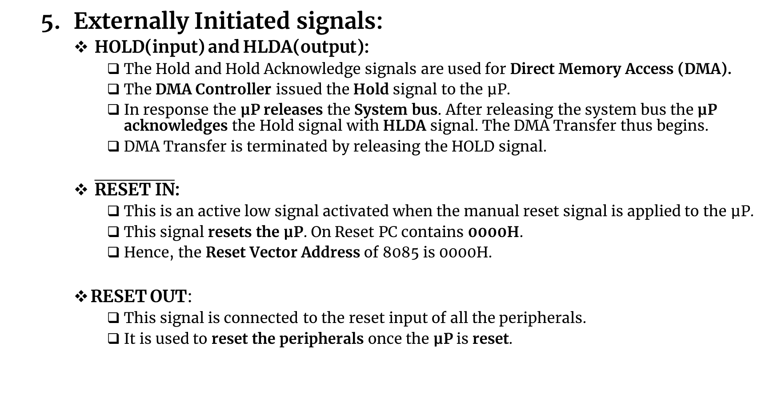
Pin Diagram (Pin Configuration) of 8085
Externally Initiated signals:
HOLD(input) and HLDA(output):
The Hold and Hold Acknowledge signals are used for Direct Memory Access (DMA).
The DMA Controller issued the Hold signal to the μP.
In response the μP releases the System bus. After releasing the system bus the μP acknowledges the Hold signal with HLDA signal. The DMA Transfer thus begins.
DMA Transfer is terminated by releasing the HOLD signal.
$\overline{\text{RESET} \text{IN}}$:
This is an active low signal activated when the manual reset signal is applied to the μP.
This signal resets the μP. On Reset PC contains 0000H.
Hence, the Reset Vector Address of 8085 is 0000H.
RESET OUT:
This signal is connected to the reset input of all the peripherals.
It is used to reset the peripherals once the μP is reset.
Notes:
When $\overline{RESET IN}$values zero,
Sets the program counter to zero (0000H).
Resets the interrupt enable and HLDA flip-flops.
Tri-states the data bus, address bus and control bus. (Note : Only during RESET is active).
Affects the contents of processor’s internal registers randomly.
HOLD : This signal indicates that another master is requesting for the use of address bus, data bus and control bus
HLDA : This active high signal is used to acknowledge HOLD request.

Slide 38
Pin Diagram (Pin Configuration) of 8085
Externally Initiated signals:
READY:
This is an active high input.
It is used by the microprocessor to sense whether a peripheral is ready or not for data transfer. If not, the processor waits.
It is thus used to synchronize the μP with "Slower" Peripherals.
The μP samples the Ready input in the beginning of every Machine Cycle.
If it is found to be LOW, the μP executes one WAIT CYCLE after which it re-samples the ready pin till it finds the Ready pin HIGH.
∴ The μP remains in the WAIT STATE until the READY pin becomes high again. Hence, if the Ready pin is not required it should be connected to the Vcc, and not, left unconnected, otherwise would cause the μP to execute infinite wait cycles.

Slide 39
Pin Diagram (Pin Configuration) of 8085
Serial I/O Ports:
The 8085 has two signals to implement the serial transmission:
SID (Serial Input Data) which is used to accept serial data bit by bit from the external device.
SOD (Serial Output Data) which enables the transmission of serial data bit by bit to the external device.
In serial transmission, data bits are sent over a single line, one bit at a time, such as the transmission over telephone lines.

Slide 40
8085 Bus Organization
The operation of a microprocessor unit includes,
Memory Read.
Memory Write.
I/O Read.
I/O Write.
Communication of a Microprocessor unit with peripheral devices involves,
Identify peripheral or memory location.
Transfer data and instruction.
Provide timing and synchronization signals.

Slide 41
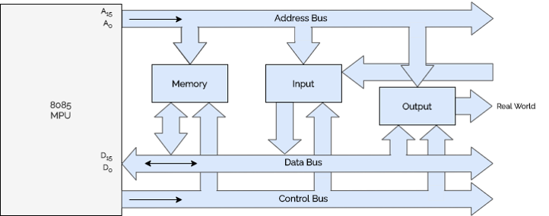
8085 Bus Organization
The microprocessor uses three sets of communication lines called buses to perform these functions.
A bus is a collection of lines, which perform the same logical task. The 8085 bus organization is shown in the figure.
8085 Bus Organization

Slide 42
8085 Bus Organization
Address Bus
Group of 16 bits from A0 to A15.
Carries the address of a particular location.
Unidirectional– Data flows from microprocessor to peripheral devices only.
Function– To identify a peripheral or a memory location.
Capable of addressing 65536(2¹⁶) memory locations. (Generally 64K)
Data Bus
Group of 8 lines used for data flow.
Carries the data to be transfered.
Bidirectional– Data flow in both direction between the microprocessor and memory / peripheral devices.
Function– To transfer binary data and instruction.
Enable the microprocessor to manipulate 8-bit data ranging from 00 to FF. (28=255)

Slide 43
8085 Bus Organization
Control Bus
Group of various single lines that carry control signals.
Microprocessor generate specific control signals for every operation.
Function– To provide timing and synchronization signals.

Slide 44
Programming with Intel 8085 Microprocessor

Slide 45
8085 ASSEMBLY LANGUAGE
Even though the instruction can be written in hexadecimal code, it is still difficult to understand a program written in hexadecimal numbers.
Therefore, each manufacturer of a microprocessor has devised a symbolic code for each instruction called mnemonic.
The mnemonic for a particular instruction consists of letters that suggest the operation to be performed by that instruction.
Example- the binary code 0011 1100 of the 8085 microprocessor is represented by the mnemonic INR A.

Slide 46
8085 MACHINE LANGUAGE
The 8085 is a microprocessor with 8 bit word length.
Its instruction set is designed by using various combinations of these 8 bits.
The 8085 is an improved version of the earlier processor 8080A.
An instruction is a binary pattern entered through an input device in memory to command the microprocessor to perform that specific function.
The 8085 microprocessor has 246 such bit patterns, amounting to 74 different instructions for performing various operations.
These 74 different instructions are called its instruction set.

Slide 47
Instruction description and Format:
An Instruction is a binary pattern which performs a specific task/function.
The computer can be used to perform a specific task, only by specifying the necessary steps to complete the task.
The collection of such ordered steps forms a ‘program’ of a computer. These ordered steps are the instructions.
Computer instructions are stored in central memory locations and are executed sequentially one at a time.
The control reads an instruction from a specific address in memory and executes it. It then continues by reading the next instruction in sequence and executes it until the completion of the program.

Slide 48
Instruction cycle:
Instruction contains in the program and is pointed by the program counter.
It is first moved to the instruction register and is decoded in binary form and stored as an instruction in the memory.
The computer takes a certain period to complete this task i.e., instruction fetching, decoding and executing on the basis of clock speed. Such a time period is called Instruction Cycle(IC) and consists two cycles namely fetch and Execute cycle.
IC=FC+EC
In the Fetch Cycle(FC), the central processing unit obtains the instruction code from the memory for its execution. Once the instruction code is fetched from memory, it is then executed.
The Execution Cycle(EC) consists the calculating the address of the operands, fetching them, performing operations on them and finally outputting the result to a specified location.

Slide 49
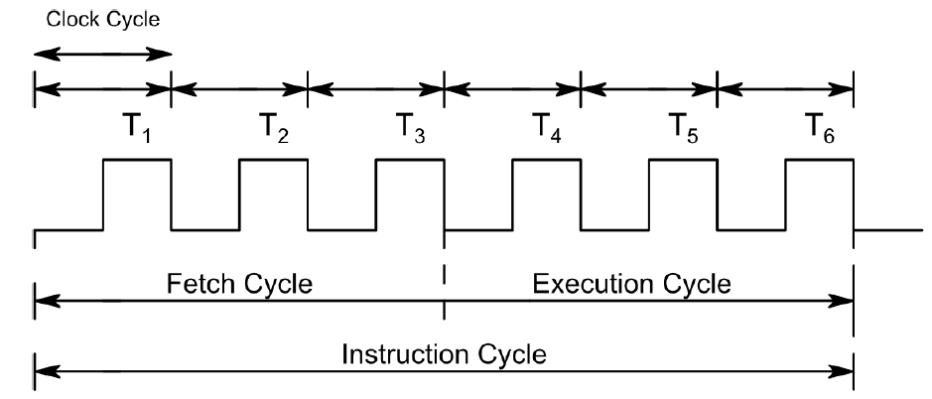
Instruction cycle:

Slide 50
Instruction description and format:
An instruction manipulates the data and a sequence of instructions constitutes a program.
Generally, each instruction has two parts: one is the task to be performed, called the operation code (Op-Code) field, and the second is the data to be operated on, called the operand or address field.
The operand (or data) can be specified in various ways. It may include 8-bit (or 16-bit) data, an internal register, a memory location, or an 8-bit (or 16-bit) address.
The Op-Code field specifies how data is to be manipulated and address field indicates the address of a data item.
For example:
ADD R₁, R₀
“Op-code” “address”
Here R0 is the source register and R1 is the destination register.
The instruction adds the contents of R0 with the content of R1 and stores result in R1.

Slide 51
Instruction description and format:
8085 A can handle at the maximum of 256 instructions (2⁸)(246 instructions are used) . The sheet which contains all these instructions with their hex code, mnemonics, descriptions and function is called an instruction sheet. Depending on the number of address specified in instruction sheet, the instruction format can be classified into the categories.
One address format (1-byte instruction):
Here 1 byte will be Op-code and operand will be default.
E.g. ADD B, MOV A, B
Two address format (2-byte instruction):
Here first byte will be Op-code and second byte will be the operand/data.
E.g. IN 40H, MVI A, 40H
Three address format (3-byte instruction):
Here first byte will be Op-code, second and third byte will be operands/data i.e. 2nd byte- lower order data. 3rd byte – higher order data
E.g. LXI B, 4050 H
Micro operation specifies the transfer of data into or out of a register.

Slide 52
Data Format of 8085 Microprocessor
The operand is an another name for data. It may appear in different forms :
Addresses
Numbers/Logical data and
Characters
Addresses : The address is a 16-bit unsigned integer ,number used to refer a memory location.
Numbers/Data : The 8085 supports following numeric data types.
Signed Integer : A signed integer number is either a positive number or a negative number. In 8085, 8-bits are assigned for signed integer, in which most significant bit is used for sign and remaining seven bits are used for Sign bit 0 indicates positive number whereas sign bit 1 indicates negative number.
Unsigned Integer : The 8085 microprocessor supports 8-bit unsigned integer.
BCD : The term BCD number stands for binary coded decimal number. It uses ten digits from 0 through 9. The 8-bit register of 8085 can store two digit BCD
Characters : The 8085 uses ASCII code to represent characters. It is a 7-bit alphanumeric code that represents decimal numbers, English alphabets, and other special characters.

Slide 53
Instruction and Data Format
An instruction (instruction format) is a command to the microprocessor to perform a given task on a particular data. Each instruction (instruction format) is of two parts. One is to be performed, called the operation code or opcode and the second one is the data to be operated on, called the operand.
Operands or data can be specified in different ways. It may include an 8-bit or 16-bit data, an internal register, a memory location, or 16-bit address. In some instructions, the operand is implicit.
Instruction Word Size - The 8085 instruction set is of three groups according to word size:
One-word or one-byte instructions.
Two-word or two-byte instructions.
Three-word or three-byte instructions.

Slide 54
Instruction and Data Format
In the 8085 microprocessor, byte and words are synonymous because it is an 8-bit microprocessor. But, instructions are commonly referred to in terms of bytes rather than words.
One-byte instructions
A one-byte instruction includes an opcode and an operand in the same byte. Operand(s) are internal registers and are in the instruction in the codes. If there is no numeral present in the instruction then that instruction will be of one-byte.
For example; MOV C, A, RAL, and ADD B, etc.
Two-byte instructions
In a two-byte instruction, the first byte specifies the operation code and the second byte specifies the operand. The source operand is a data byte and immediately following the opcode. If an 8-bit numeral is present in the instruction then that instruction will be of two-byte. Here, the numeral may be a data or an address.
For example, in MVI A, 35H and IN 29H, etc. In a two-byte instruction, the first byte will be the opcode and the second byte will be for the numeral present in the instruction.

Slide 55
Instruction and Data Format
Three-byte instructions
In a three-byte instruction, the first byte specifies the opcode, and the following two bytes specify the 16-bit operand. The second byte is the low-order operand and the third byte is the high-order operand. If a 16-bit numeral is present in the instruction then that instruction will be of three-byte. Here, the numeral may be a data or an address.
For example, in LXI H,3500H and STA 2500H, etc.

Slide 56
Addressing Modes in 8085
There are five addressing modes in 8085.
Immediate Addressing Mode: An immediate is transferred directly to the register.
E.g.: MVI A, 30H (30H is copied into the register A)
MVI B,40H(40H is copied into the register B).
Register Addressing Mode: Data is copied from one register to another register.
E.g.: MOV B, A (the content of A is copied into the register B)
MOV A, C (the content of C is copied into the register A).
Direct Addressing Mode: Data is directly copied from the given address to the register.
E.g.: LDA 3000H (The content at the location 3000H is copied to the register A).
Indirect Addressing Mode: The data is transferred from the address pointed by the data in a register to other register.
E.g.: MOV A, M (data is transferred from the memory location pointed by the register to the accumulator).
Implied Addressing Mode: This mode doesn't require any operand. The data is specified by opcode itself.
E.g.: RAL, CMP

Slide 57
Addressing Modes in 8085
Instructions are command to perform a certain task in microprocessor.
The instruction consists of op-code and data called operand. The operand may be the source only, destination only or both of them.
In these instructions, the source can be a register, a memory or an input port.
Similarly, destination can be a register, a memory location, or an output port.
The various format (way) of specifying the operands are called addressing mode. So addressing mode specifies where the operands are located rather than their nature.
The 8085 has 5 addressing modes:
Direct addressing mode
Register Direct addressing mode
Register Indirect addressing mode
Immediate addressing mode
Implied or Inherent addressing mode

Slide 58
Direct addressing mode
The instruction using this mode specifies the effective address as part of instruction.
The instruction size either 2-bytes or 3-bytes with first byte op-code followed by 1 or 2 bytes of address of data.
E. g.:
LDA 9500H A ← [9500]
IN 80H A ← [80]
This type of addressing is called absolute addressing.

Slide 59
Register Direct addressing mode
This mode specifies the register or register pair that contains the data.
E g.:
MOV A, B → Here register B contains data rather than address of the data.
Other examples are: ADD, XCHG etc.

Slide 60
Register Indirect addressing mode
In this mode, the address part of the instruction specifies the memory whose contents are the address of the operand.
So in this type of addressing mode, it is the address of the address rather than address itself. (One operand is register)
E.g.
MOV R, M; MOV M, R; STAX, LDAX etc.
STAX B; B= 95 C =00
[9500] ← A

Slide 61
Immediate addressing mode
In this mode, the operand position is the immediate data.
For 8-bit data, instruction size is 2 bytes and for 16-bit data, instruction size is 3 bytes.
E.g.:
MVI A, 32H
LXI B, 4567H

Slide 62
Implied or Inherent addressing mode
The instructions of this mode do not have operands.
E.g.:
NOP: No operation
HLT: Halt
EI: Enable interrupt
DI: Disable interrupt
CMA: Complement Accumulator

Slide 63
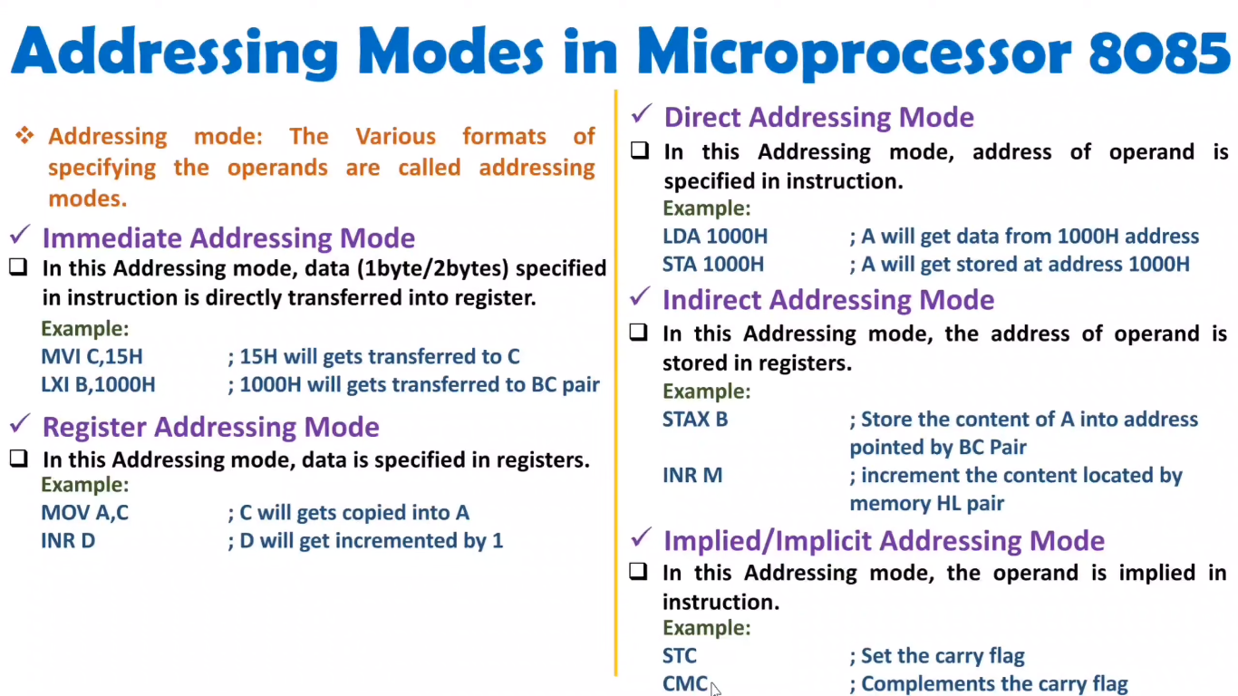

Slide 64
Addressing Modes in 8085
Q) What do you mean by addressing modes in microprocessor? Explain all the addressing modes of 8085 up with suitable example for each.

Slide 65
Classification of Instruction
An instruction is a binary pattern designed inside a microprocessor to perform a specific function (task). The entire group of instructions called the instruction set.
The 8085 instruction set can be classified in to 5- different groups.
Data transfer group: The instructions which are used to transfer data from one register to another register or register to memory and vice-versa.
Arithmetic group: The instructions which perform arithmetic operations such as addition, subtraction, increment, decrement etc.
Logical group: The instructions which perform logical operations such as AND, OR, XOR, COMPARE etc.
Branching group: The instructions which are used for looping and branching are called branching instructions like jump, call etc.
Miscellaneous group: The instructions relating to stack operation, controlling purposes such as interrupt operations are fall under miscellaneous group including machine control like HLT, NOP.

Slide 66
Data Transfer group Instructions
It is the longest group of instructions in 8085.
This group of instruction copy data from a source location to destination location without modifying the contents of the source.
The transfer of data may be between the registers or between register and memory or between an I/O device and accumulator.
None of these instructions changes the flag.
The instructions of this group are:

Slide 67
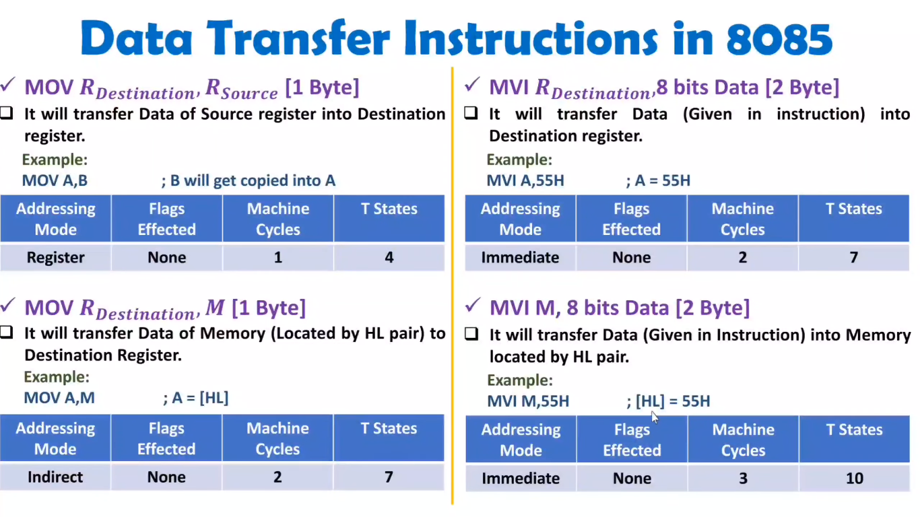

Slide 68
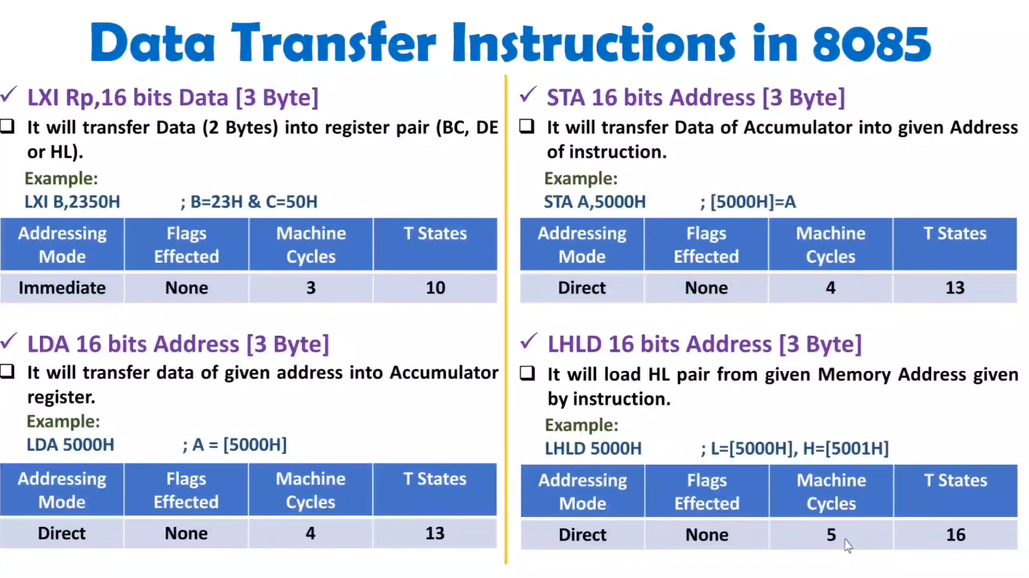

Slide 69
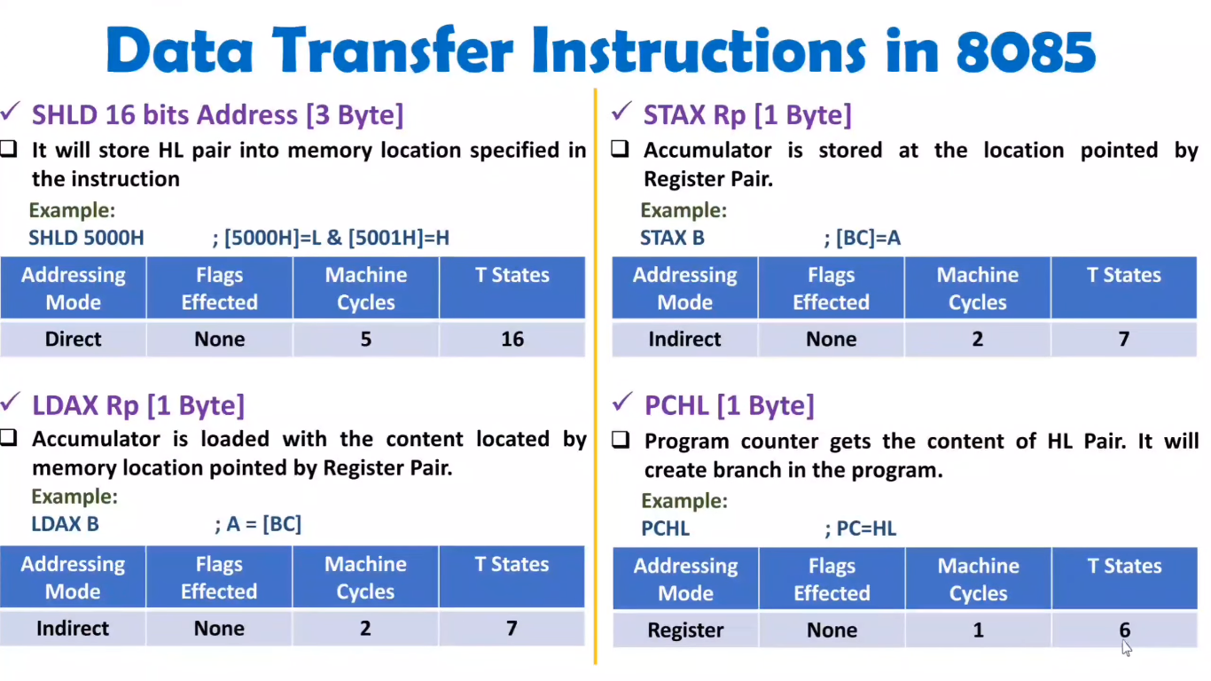

Slide 70
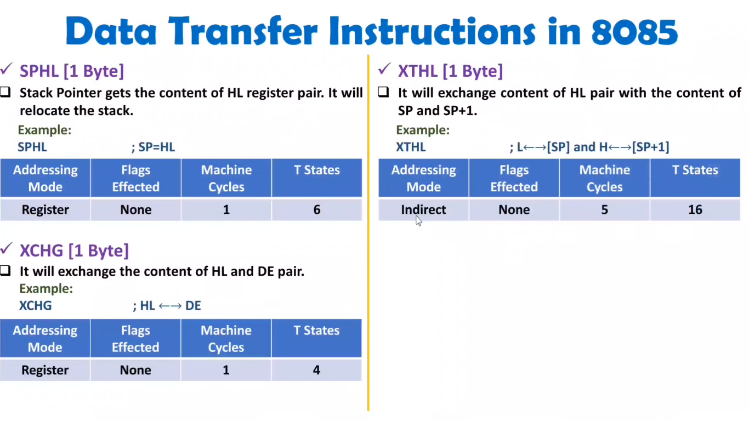

Slide 71
Arithmetic group Instructions
The 8085 microprocessor performs various arithmetic operations such as addition, subtraction, increment and decrement.
These arithmetic operations have the following mnemonics.

Slide 72
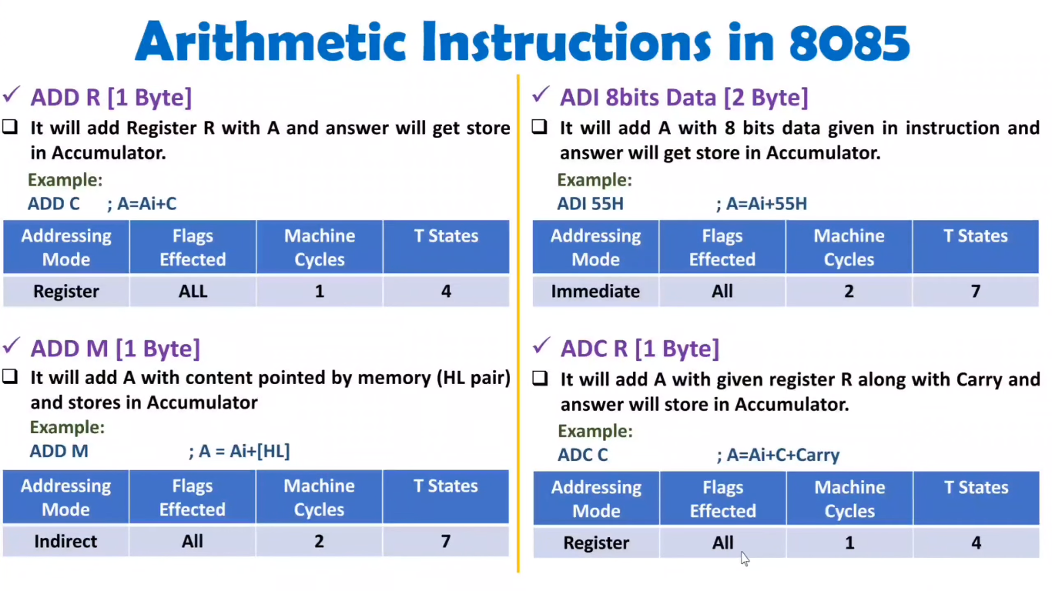

Slide 73
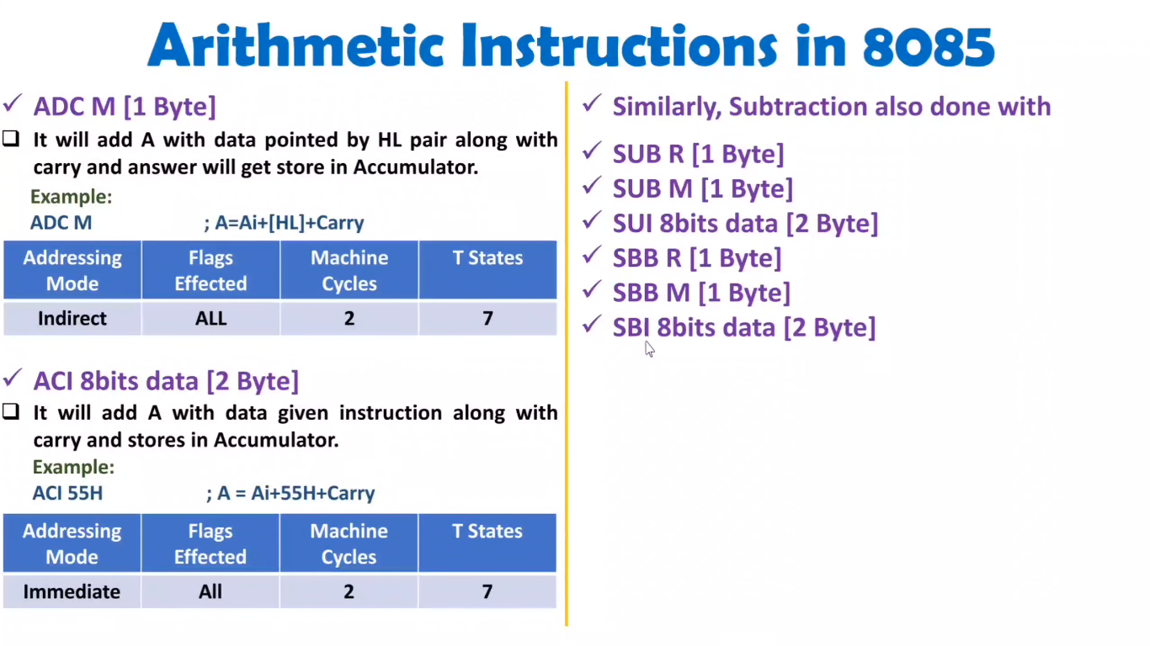

Slide 74
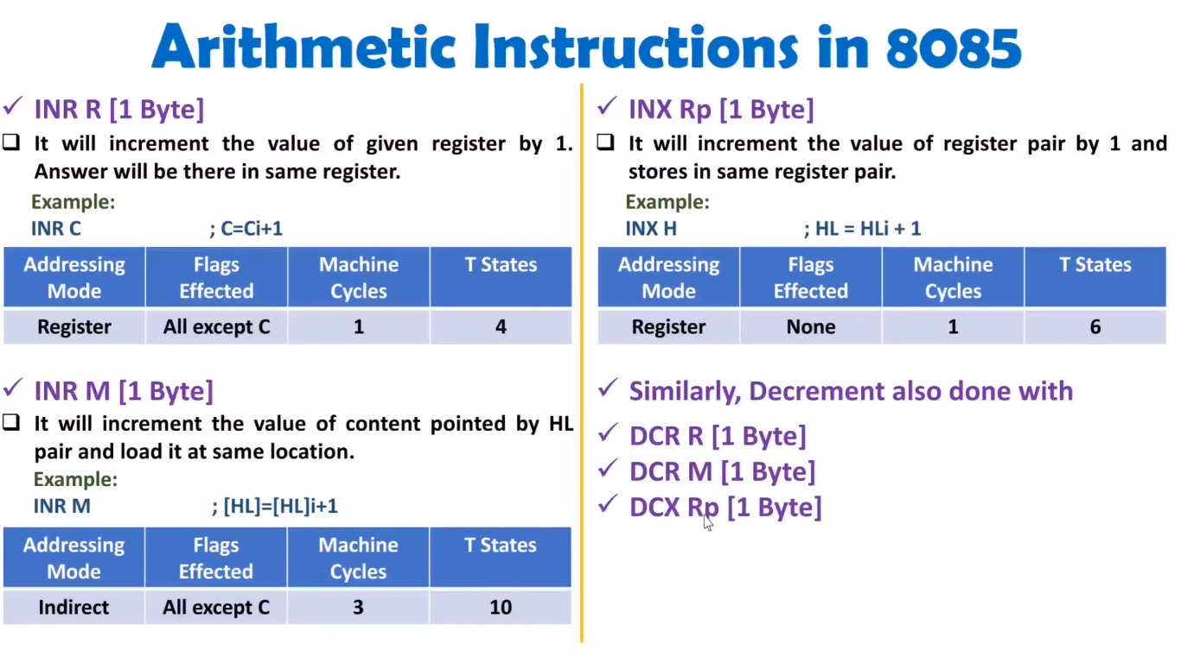

Slide 75
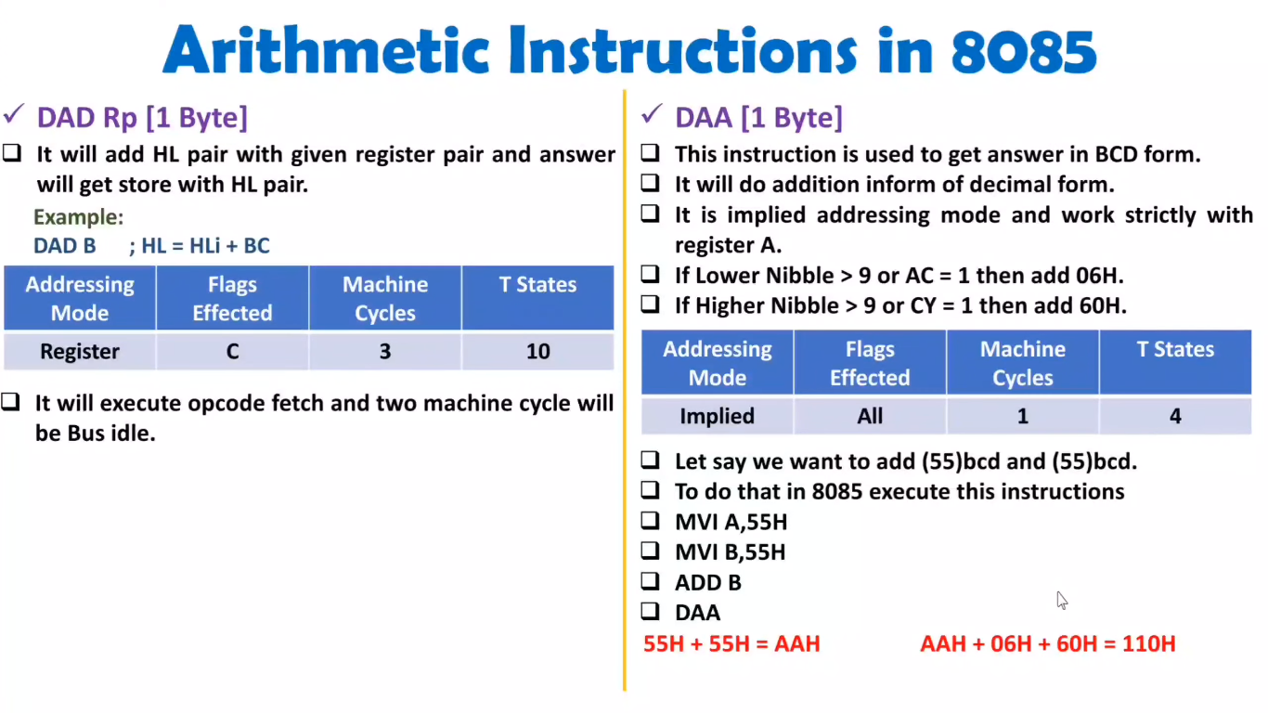
(Decimal Adjust Accumulator)

Slide 76
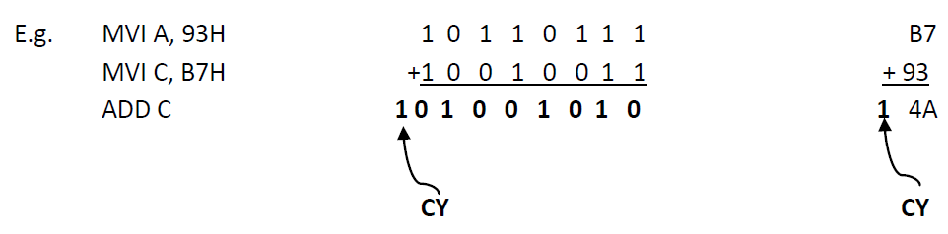
Addition operation in 8085
8085 performs addition with 8-bit binary numbers and stores the result in accumulator. If the sum is greater than 8-bits (FFH), it sets the carry flag.

Slide 77
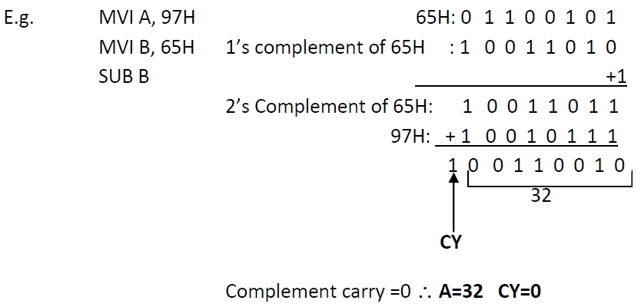
Subtraction operation in 8085
8085 performs subtraction operation by using 2’s complement and the steps used are:
Converts the subtrahend (the number to be subtracted) into its 1’s complement.
Adds 1 to 1’s complement to obtain 2’s complement of the subtrahend.
Adds 2’s complement to the minuend (the contents of the accumulator).
Complements the carry flag.

Slide 78
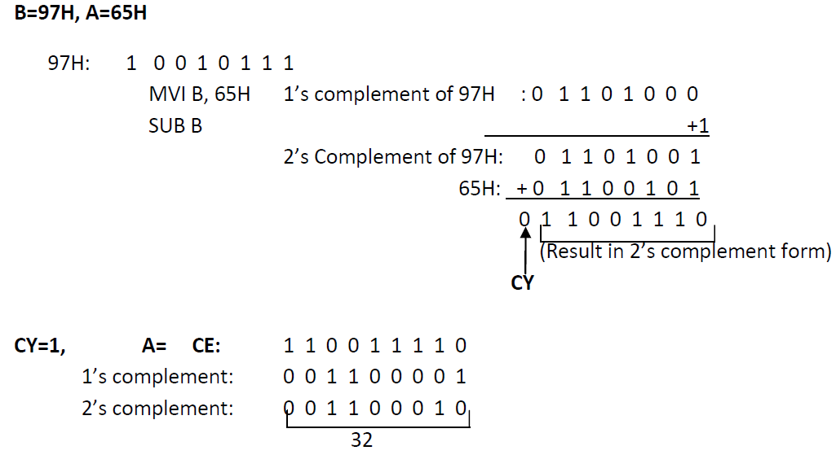
Subtraction operation in 8085

Slide 79
Logical group Instructions
A microprocessor is basically a programmable logic chip.
It can perform all the logic functions of the hardwired logic through its instruction set.
The 8085 instruction set includes such logic functions as AND, OR, XOR and NOT (Complement).
The following features hold true for all logic instructions:
The instructions implicitly assume that the accumulator is one of the operands.
All instructions reset (clear) carry flag except for complement where flag remain unchanged.
They modify Z, P & S flags according to the data conditions of the result.
Place the result in the accumulator.
They do not affect the contents of the operand register.

Slide 80
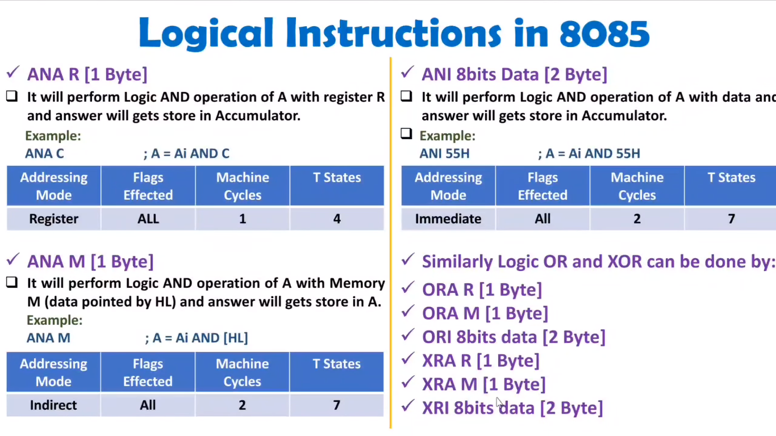

Slide 81
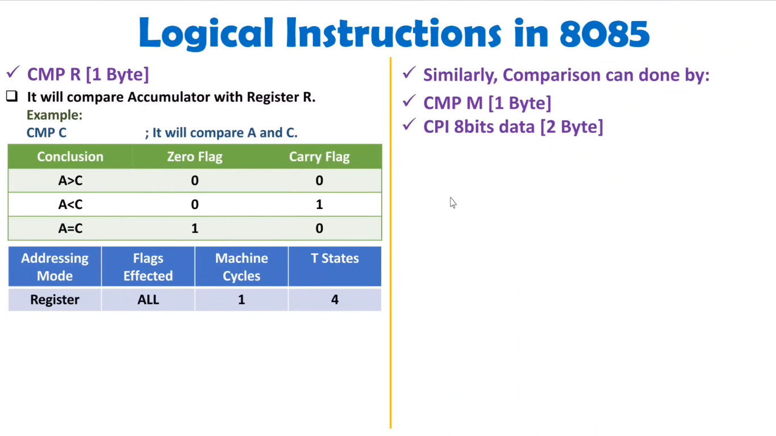

Slide 82
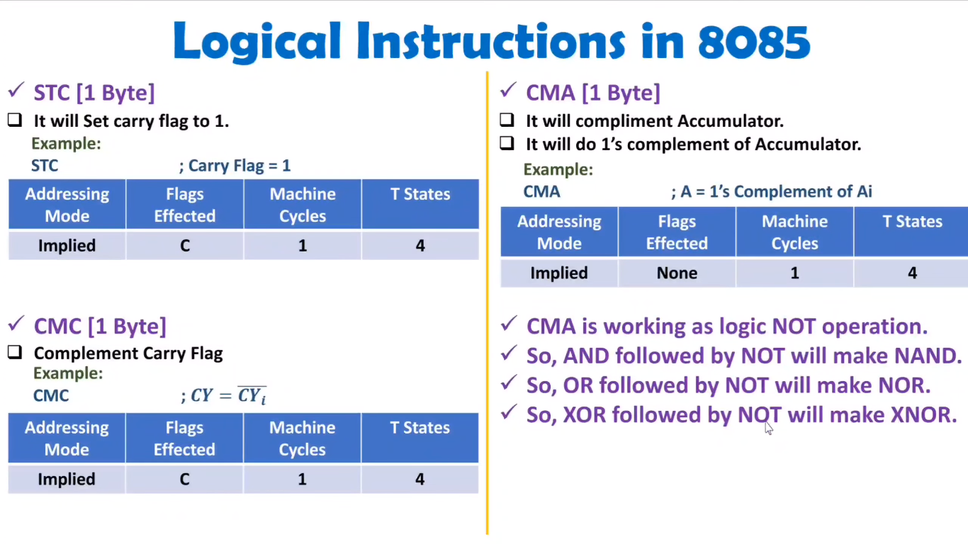

Slide 83
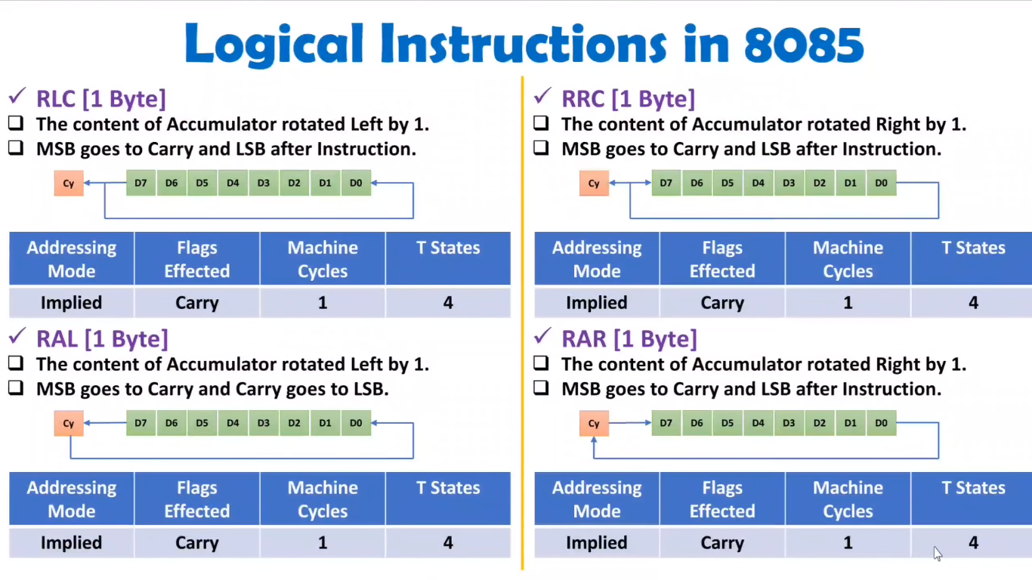
(Rotate Accumulator Left without Carry)
(Rotate Accumulator Right without Carry)
(Rotate Accumulator Left Through Carry)
(Rotate Accumulator Right Through Carry)

Slide 84
Binary to Gray Code Conversion: 8085 ALP
LDA C050H
MOV B, A
RAR
XRA B
STA C051H
HLT

Slide 85
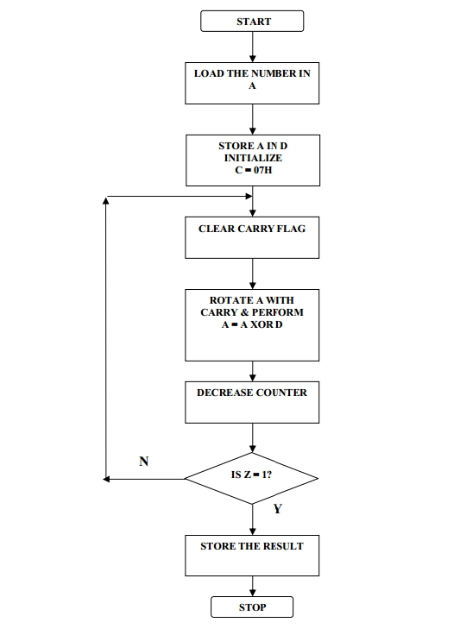
Gray to Binary Code Conversion: 8085 ALP

Slide 86
Gray to Binary Code Conversion: 8085 ALP
LDA C050
MOV D,A
MVI C,07
UP: RAR
XRA D
DCR C
JNZ UP
STA C051
HLT
LDA C050H
MOV D, A
MVI C, 07H
Up: STC
CMC
RAR
XRA D
DCR C
JNZ Up
STA C051H
HLT

Slide 87
Branching group Instructions
The branching instructions instruct the microprocessor to go to a different memory location and the microprocessor continues executing machine codes from that new location.
The branching instructions are the most powerful instructions because they allow the microprocessor to change the sequence of a program, either unconditionally or under certain test conditions.
The branching instruction code categorized in following three groups:
Jump instructions
Call and return instruction
Restart instruction

Slide 88
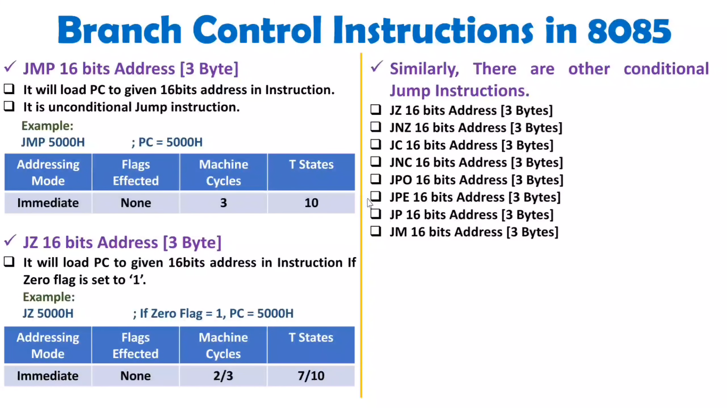

Slide 89
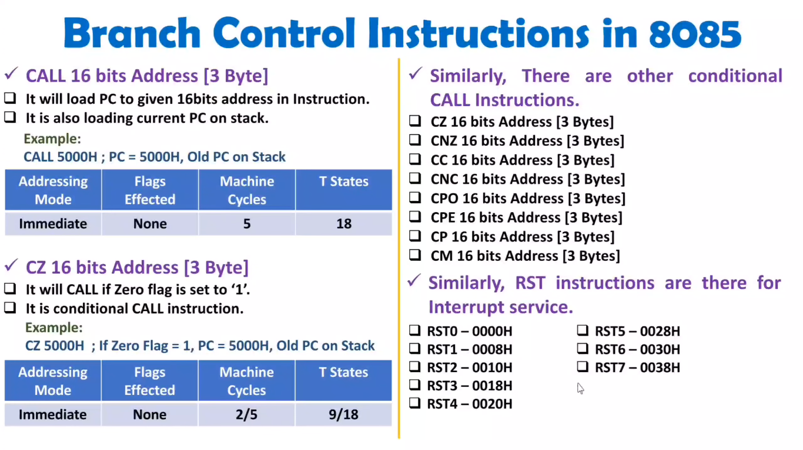

Slide 90
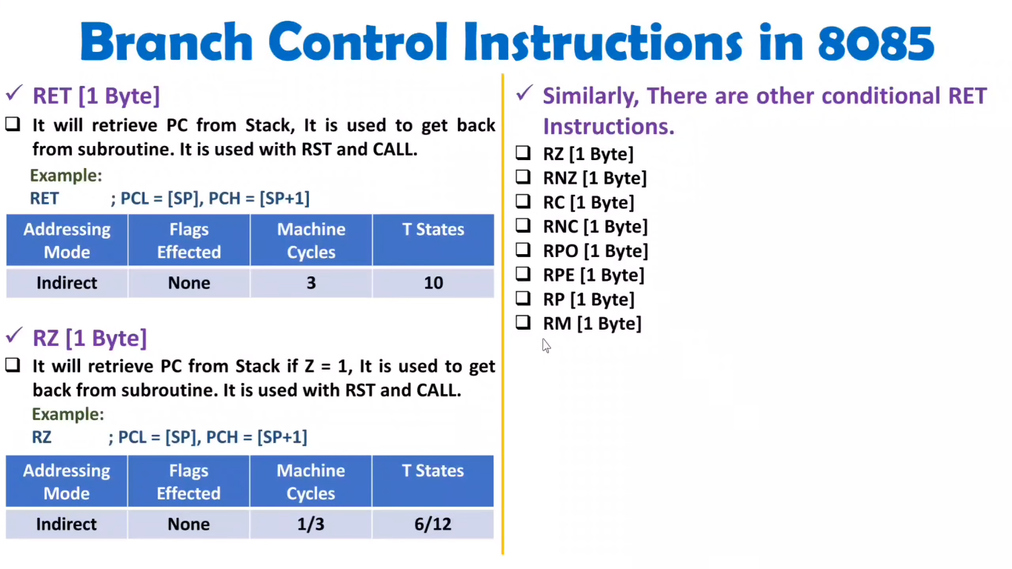

Slide 91
8085 program to add two 8 bit numbers with Carry
MVI C, 00H
LDA 4300H
MOV B, A
LDA 4301H
ADD B
JNC loop
INR C
Loop: STA 4302
MOV A, C
STA 4302
MOV A, C
STA 4303
HLT
LXI H, 2000H
MOV A, M
INX H
MOV B, M
MVI C, 00H
ADD B
JNC down
INR C
INX H
down: MOV M, A
INX H
MOV M, C
HLT

Slide 92
Packing of BCD Numbers
Input Data
PROGRAM:
LDA C201H
RLC
RLC
RLC
RLC
ANI F0H
MOV C, A
LDA C200H
ADD C
STA C300H
HLT
Memory Address(H) | Data(H)
C200 | 04
C201 | 09
RESULT
Memory Address(H) | Data(H)
C300 | 94

Slide 93
Unpacking of BCD Numbers
Input Data
PROGRAM:
LDA C200H
ANI F0H
RLC
RLC
RLC
RLC
STA C300H
LDA C200H
ANI 0FH
STA C301H
HLT
Memory Address(H) | Data(H)
C200 | 58
RESULT
Memory Address(H) | Data(H)
C300 | 08
C301 | 05

Slide 94
Assignment
Q) Explain the instructions that fall in data transfer, arithmetic and logical groups with example. Show how the flags are affected by each instruction. [10]

Slide 95
ALP with 8085
Q1) WAP to move 10 bytes of data from starting address 9500 H to 9600H.
9500H
9600H
9509H
9609

Slide 96
ALP with 8085
Q1) WAP to move 10 bytes of data from starting address 9500 H to 9600H.
Solution:
MVI C, 0AH
LXI H, 9500H
LXI D, 9600H
up: MOV A, M
STAX D ; Store the contents of accumulator to register pair.
INX H ; Increment the register pair HL by 1
INX D ; Increment the register pair DE by 1
DCR C
JNZ up
HLT

Slide 97
ALP with 8085
Q2) Write to transfer 30 data starting from 8500 to 9500H if data is odd else store 00H.
Solution:
MVI B, 1EH
LXI H, 8500H
LXI D, 9500H
L2: MOV A, M
ANI 01H
JNZ L1 ; If data is odd then go to L1.
MVI A, 00H
JMP L3
L1: MOV A, M
L3: STAX D
INX D
INX H
DCR B
JNZ L2
HLT
MVI C,1E
LXI H,2500
LXI D,2600
UP: MOV A,M
MOV B,A
RRC
JC DOWN
MVI B,00
DOWN: MOV A,B
STAX D
INX H
INX D
DCR C
JNZ UP
HLT

Slide 98
Miscellaneous group Instructions
This group of instructions are also called Stack Operation, I/O and Machine Control Instructions group.

Slide 99
Stack in 8085
The stack in an 8085 can be described as a reserved area of the memory in the R/W memory where we can store temporary information.
It is a shared resource as it can be shared by the microprocessor and the programmer.
Programmers use the stack to store data and the microprocessors use the stack to execute subroutines.
The 8085 has a 16-bit register known as the Stack Pointer.
The function of the stack pointer is to hold the starting address of the stack. This address can be decided by the programmer.

Slide 100
Stack in 8085
The stack operates on the Last In, First Out (LIFO) principle.
The location of the most recent data on the stack is known as the TOP of the stack.
The stack pointer always points to the top of the stack.
Contents can be stored in the stack using the PUSH instruction and can restore the contents by using the instruction POP.

Slide 101
Stack in 8085
MNEMONIC | DESCRIPTION
LXI SP, 16-bit | Load the stack pointer register with a 16-bit address.
PUSH R_{p} | Copies the contents of the specified register pair on the stack
POP R_{p} | Copies the contents of the top two memory locations of the stack into the specified register pair.

Slide 102
PUSH and POP Operation in 8085
PUSH Rp/PSW
This is a 1-byte instruction. This instruction copies the contents of the specified register pair on the stack as described below:
The stack pointer is decremented and the contents of the higher-order register are copied to the location shown by the stack pointer register.
The stack pointer is again decremented and the contents of the low-order register are copied to that location.
POP Rp/PSW
This is a 1-byte instruction. This instruction copies the contents of the top two memory locations of the stack into the specified register pair.
First, the contents of the memory location indicated by the stack pointer register are copied into the low-order register and then the stack pointer register is incremented by 1.
The contents of the next memory location are copied into the high-order register and the stack pointer register is again incremented by 1.
Notes:
What is PSW in 8085 processor?
In 8085 microprocessors, PSW stands for Program Status word. It is a 16-bit word, a combination of contents of the 8-bit flag register and the contents of an 8-bit Accumulator register.

Slide 103
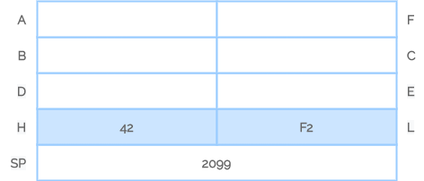
PUSH and POP Operation in 8085
Example:
LXI SP, 2099H
LXI H, 42F2H
PUSH H
Delay Counter
POP H
HLT
The instruction LXI SP, 2099H will initialize the stack pointer with the address of 2099H.
LXI H, 42F2H will initialize or load HL register pair with 42F2H data so H = 42 and L = F2.

Slide 104
PUSH and POP Operation in 8085
After the execution of PUSH H instruction the stack pointer is decreased by one to 2098H and the contents of the H register are copied to memory location 2098H.
The stack pointer is again decreased by one to 2097H and the contents of the L register are copied to memory location 2097H.

Slide 105
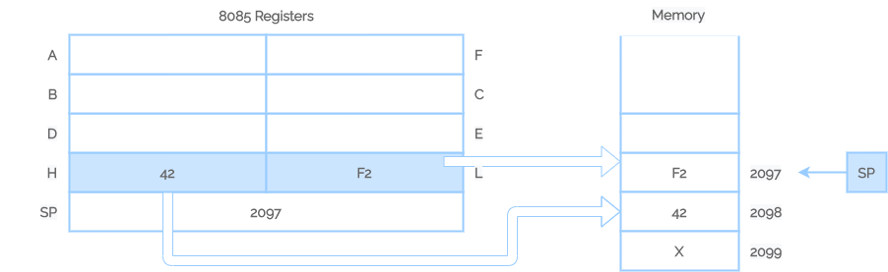
PUSH and POP Operation in 8085
Contents of Stack and Registers After PUSH Operation

Slide 106
PUSH and POP Operation in 8085
After the execution of POP H instruction, the contents of the top of the stack location shown by the stack pointer are copied in the L register and the stack pointer is increased by one to 2098H.
The contents of the top of the stack are copied in the H register and the stack pointer is increased by one.
The contents of the memory locations 2097H and 2098H are not destroyed until some other data bytes are stored in these locations.

Slide 107
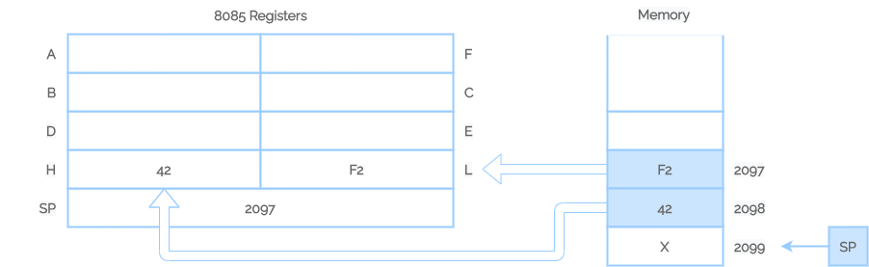
PUSH and POP Operation in 8085
Contents of Stack and Registers After POP Operation

Slide 108
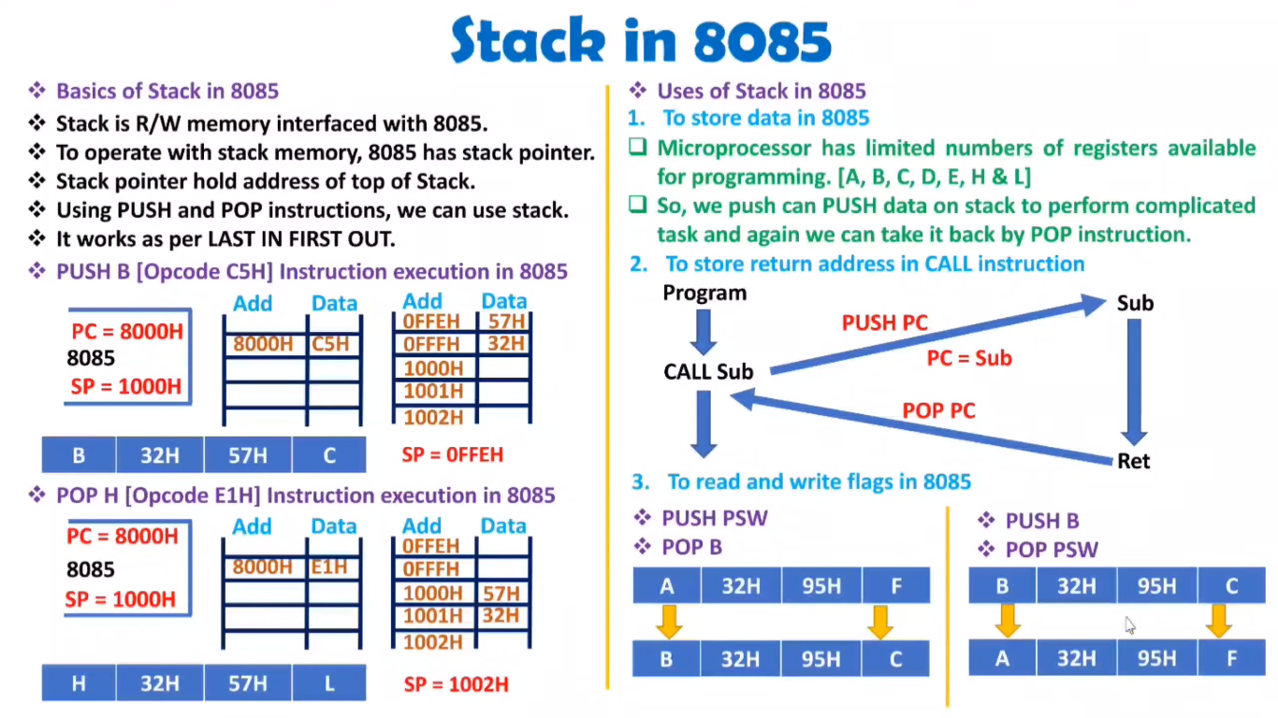

Slide 109
ALP Example of Stack Operation
E.g.:
LXI SP, 1FFFH
LXI H, 9320H
LXI B, 4732H
LXI D, ABCDH
MVI A, 34H
PUSH H
PUSH B
PUSH D
PUSH PSW
POP H
POP B
POP D
POP PSW
HLT
BEORE EXECUTION
H = 93 L = 20
B = 47 C = 32
D = AB E = CD
A = 34 F = 10
AFTER EXECUTION
H = 34 L = 10
B =AB C = CD
D = 47 E = 32
A = 93 F = 20
Note: STACK Works in LIFO (Last In First Out) manner.

Slide 110
Miscellaneous group Instructions
Interrupt related Instructions;
SIM – Set Interrupt Mask
RIM – Read Interrupt Mask
DI – Disable Interrupt
EI – Enable Interrupt

Slide 111
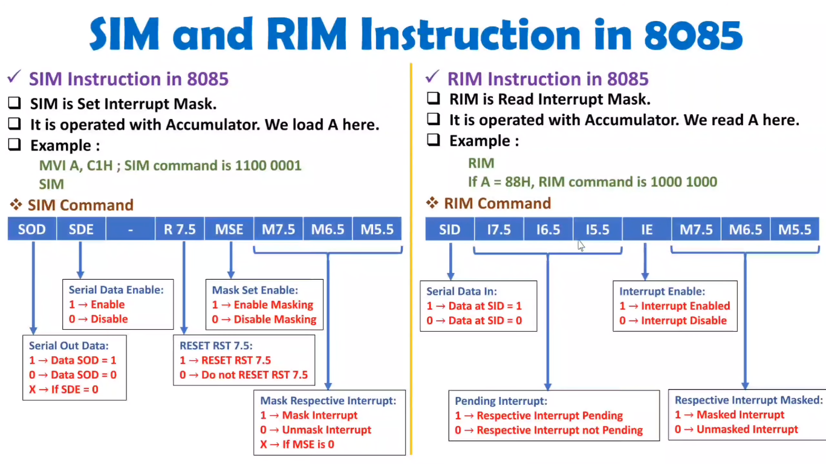

Slide 112
Miscellaneous group Instructions
Interrupt related Instructions;
DI: Disable Interrupts
The Interrupt Enable flipflop is reset and all the interrupts except the TRAP are disabled.
No flags are affected.
This instruction is commonly used when the execution of a code sequence cannot be interrupted.
For example, in critical time delays, this instruction is used at the beginning of the program and the interrupts are enabled at the end of the program.
The 8085 TRAP cannot be disabled.
Opcode | Operand | Bytes | M-Cycles | T-States | Hex Code
DI | None | 1 | 1 | 4 | F3

Slide 113
Miscellaneous group Instructions
Interrupt related Instructions;
EI: Enable Interrupts
The Interrupt Enable flipflop is set and all the interrupts enabled.
No flags are affected.
After a system reset or the acknowledgement of an interrupt, the Interrupt Enable flip-flop is reset, thus disabling the interrupts.
This instruction is necessary to reenable the interrupts (except TRAP).
Opcode | Operand | Bytes | M-Cycles | T-States | Hex Code
EI | None | 1 | 1 | 4 | FB

Slide 114
Miscellaneous group Instructions
Machine Control Instructions;
NOP – No Operation
HLT – Halt the program

Slide 115
Miscellaneous group Instructions
HLT: Halt and Enter Wait State
The MPU finishes the current instruction and halts any further execution
The MPU enters the Halt Acknowledge machine cycle and Wait states are inserted in every clock period. The address and data bus are placed in the high impedance state.
The contents of the registers are unaffected during HLT state.
An interrupt or reset is necessary to exit from the Halt state.
No flags are affected.
NOP: No Operation
No operation is performed
Instruction is fetched and decoded; however, no operation is executed.
The instruction is used to fill in time delays or to delete and insert instructions while troubleshooting.
Opcode | Operand | Bytes | M-Cycles | T-States | Hex Code
HLT | None | 1 | 2 or more | 5 or more | 76
Opcode | Operand | Bytes | M-Cycles | T-States | Hex Code
NOP | None | 1 | 1 | 4 | 00

Slide 116
Miscellaneous group Instructions
Peripheral Input/Output Instructions;
The 8085 microprocessor has two instructions for data transfer between the processor and I/O device: IN and OUT.
IN 8-bit Port Address: Input Data to Accumulator from a Port with 8-bit Address
The contents of the input port(00H-FFH) designated in the operand are read and loaded in to the accumulator.
E.g.: IN 40H; A ← [40H]
OUT 8-bit Port Address: Output Data from Accumulator to a Port with 8-bit Address
The contents of the accumulator are copied into the output port specified by the operand.
E.g.: OUT 01H; [01H] ← A
Opcode | Operand | Bytes | M-Cycles | T-States | Hex Code
IN | 8-bit port address | 2 | 3 | 10 | DB
Opcode | Operand | Bytes | M-Cycles | T-States | Hex Code
OUT | 8-bit port address | 2 | 3 | 10 | D3

Slide 117
ALP with 8085
Q) WAP to sort in ascending order for 10 bytes from 1120H.
Solution:
MVI B,09
LOOP2: LXI H,3000
MVI C,09
LOOP1: MOV A,M
INX H
CMP M
JC SKIP; jnc for descending
MOV D,M
MOV M,A
DCX H
MOV M,D
INX H
SKIP: DCR C
JNZ LOOP1
DCR B
JNZ LOOP2
HLT
Note: For sorting in Descending order use JNC instead JC.

Slide 118
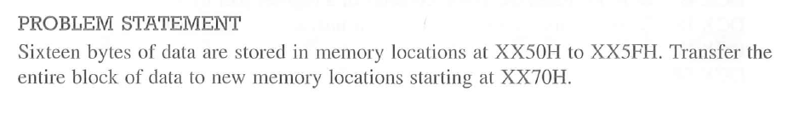
ALP with 8085

Slide 119
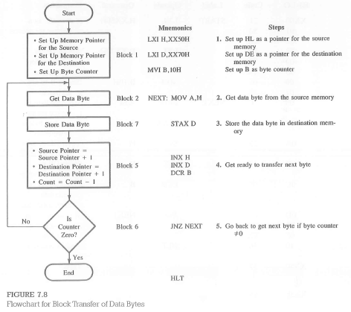
ALP with 8085

Slide 120
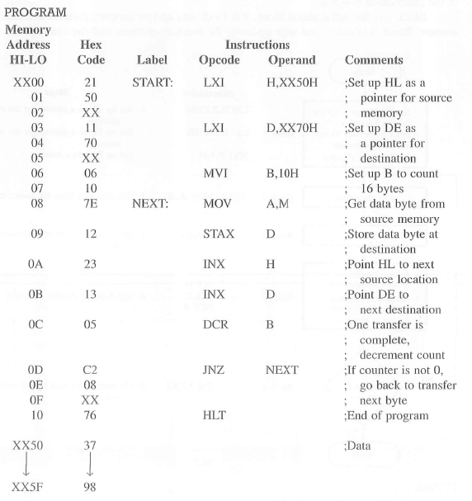
ALP with 8085

Slide 121
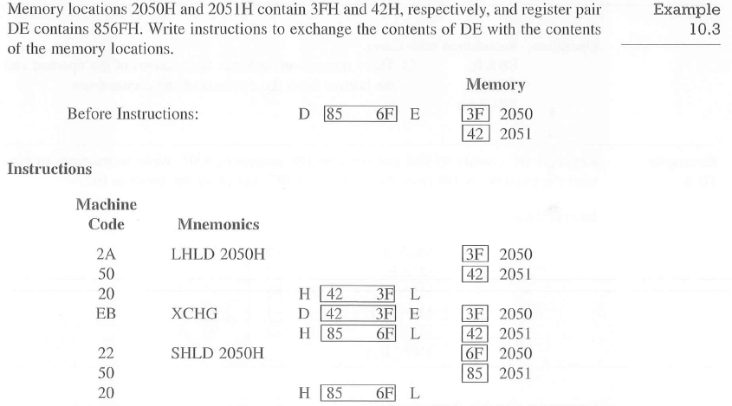
ALP with 8085

Slide 122
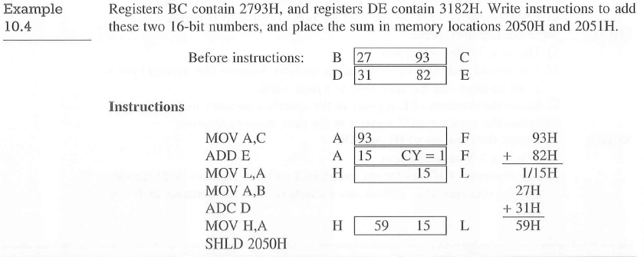
ALP with 8085

Slide 123
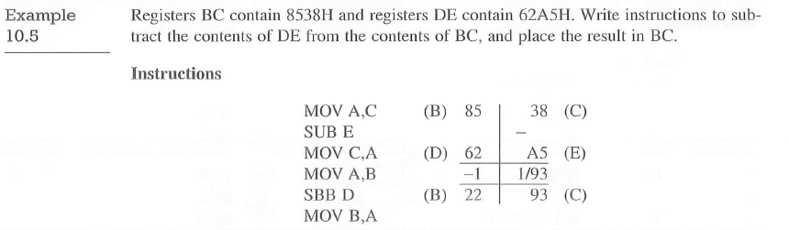
ALP with 8085

Slide 124
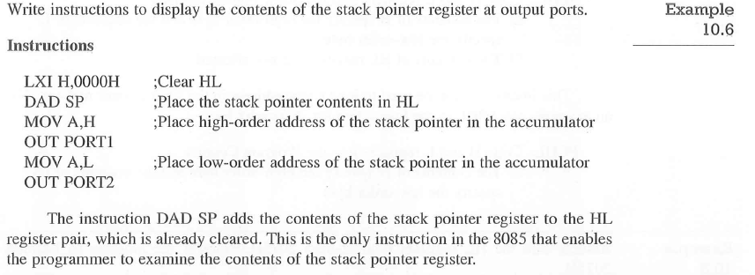
ALP with 8085

Slide 125
BCD-TO-BINARY(HEX) CONVERSION
The conversion of a BCD number into its binary equivalent employs the principle of positional weighting in a given number
For example: 72₁₀ = 7*10 + 2
The digit 7 represents 70, based on its second position from the right . Therefore, converting 72_{BCD} into its binary equivalent requires multiplying the second digit by 10 and adding the first digt.
Converting a 2-digit BCD number into its binary equivalent requires the following steps:
Step-1: Separate an 8-bit packed BCD number into two 4-bit unpacked BCD digits: BCD₁ and BCD₂.
Step-2: Convert each digit into its binary value according to its position
Add both binary numbers to obtain the binary equivalent of the BCD number.

Slide 126
BCD-TO-BINARY(HEX) CONVERSION
EXAMPLE: Convert 72_{BCD} into its binary equivalent.
Solution:
Step 1: 0111 0010 → 0000 0010 Unpacked BCD₁.
→ 0000 0111 Unpacked BCD₂.
Step 2: Multiply BCD₂ by 10 (7 x 10)
Step 3: Add BCD₁ to the answer in Step 2

Slide 127
BCD-TO-BINARY(HEX) CONVERSION
PROGRAM
LDA 3000H
MOV B, A
ANI 0FH
MOV C, A
MOV A, B
ANI F0H
RRC
RRC
RRC
RRC
MOV D, A
XRA A
MVI E, 0AH
UP: ADD D
DCR E
JNZ UP
ADD C
STA 3001H
HLT

Slide 128
BINARY-TO-BCD CONVERSION
The conversion of binary to BCD is performed by dividing the number by the powers of ten; the division is performed by the subtraction method.
For example, assume the binary number is
1 1 1 1 1 1 1 1₂ (FFH) = 255₁₀
To represent this number in BCD requires twelve bits or three BCD digits, labeled here as BCD₃ (MSB), BCD₂, and BCD₃ (LSB).
= 0 0 1 0 0 1 0 1 0 1 01
BCD₃ BCD₂ BCD₁

Slide 129
BINARY-TO-BCD CONVERSION
PROGRAM:
START: LXI SP, 1999H
LXI H, 2000H; Source
LXI H, 2100H; Destination
MOV A, M
CALL BCDBIN
STAX
HLT
BCDBIN: PUSH B
PUSH D
MOV B, A
ANI 0FH
MOV C,A
MOV A, B
ANI F0H
JZ BCD₁
RRC
RRC
RRC
RRC
MOV D, A
XRA A
MVI E, 0AH
SUM: ADD E
DCR D
JNZ SUM
BCD₁: ADD C
POP D
POP B
RET

Slide 130
BINARY-TO-BCD CONVERSION
The conversion can be performed as follows:
Step 1: If the number is less than 100, go to Step 2; otherwise, divide by 100 or subtract 100 repeatedly until the remainder is less than 100.. The quotient is the most significant BCD digit, BCD₃.
Step 2: If the number is less than 10, go to Step 3; otherwise divide by 10 repeatedly until the remainder is less than 10. The quotient is BCD₂.
Step 3: The remainder from Step 2 is BCD₃.
E.g. 1111 1111₂ (FFH) = 255₁₀ = 0010 0101 0101_{BCD}

Slide 131
BINARY-TO-BCD CONVERSION
PROGRAM:
LXI SP, 1999H
LXI H, 2020H; Source
MOV A, M
CALL PWRTEN
HLT
PWRTEN: LXI H, 2030H; Destination
MVI B, 64H
CALL BINBCD
MVI B, 0AH
CALL BINBCD
MOV M, A
RET
BINBCD: MVI M, FFH
NEXT: INR M
SUB B
JNC NEXT
ADD B
INX H
RET

Slide 132
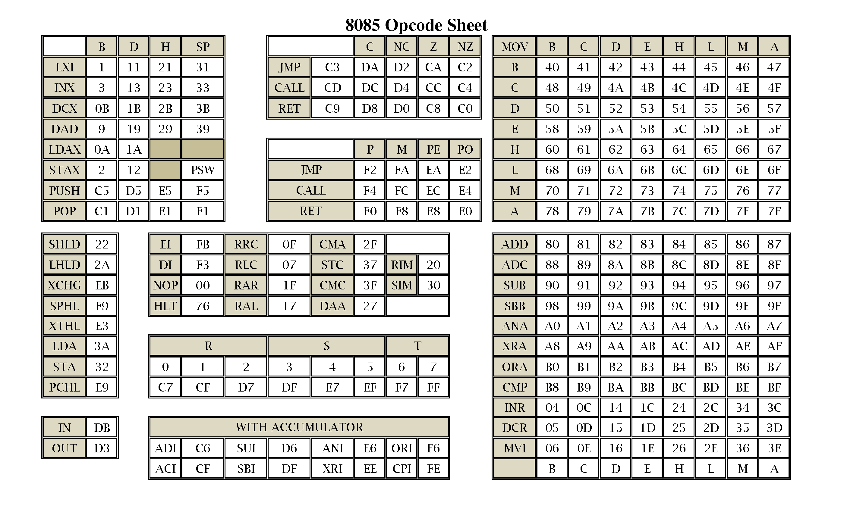

Slide 133
For your reference of 8085 Microprocessor:
Visit YouTube playlist: Microprocessor and Microcontroller(lec 1 – lec 20) by Prof. Ajit Pal on YouTube channel Satish Kashyap
Link: https://www.youtube.com/playlist?list=PL0E131A78ABFBFDD0

Slide 134
Counters and Time Delays in 8085
Microprocessors perform different operations in sequence and one operation at a time. To complete an opera­tion, some time is required.
When some time delay is required between two operations, a Time Delay Loop in Microprocessor is used to provide it.
Time delay can be generated using a register or a register pair.
Initially, a register is loaded with an oper­and or number, depending on the time delay required, and then the number is decremented until it reaches zero setting up a loop with a conditional jump instruction. So a conditional jump instruction is used in a delay loop to come out from the loop.
Figure 4.9 shows the flowchart of time delay loop using One register.

Slide 135
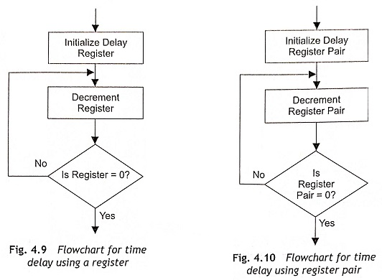
Counters and Time Delays in 8085

Slide 136
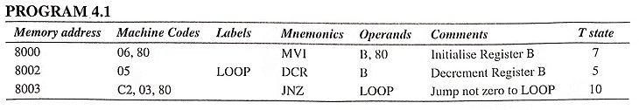
Calculation of Time Delay Using One Register
The typical instructions of a Time Delay Loop in Microprocessor are given below:
It is clear from the above instructions that MVI B, 80H requires seven clock cycles, DCR B requires 5 clock pulse and JNZ also requires 10 clock pulses during execution.
When these instructions are executed, MVI B, 80H instruction is executed once and the next two instructions are executed 128 times.
The number of T states for execution of LOOP is

Slide 137
Calculation of Time Delay Using One Register
The delay time to execute the LOOP instruction is T_{L} = T x number of T states for execution of LOOP, where T is the system clock period. When the microprocessor operates in 5 MHz clock frequency,
The total time delay T_{D} is calculated from the summation of time to execute instruction of outside LOOP, T_{OL} and time to execute LOOP instruction, T_{L}.
Using only one register in a delay loop, a limited time delay is generated.
If very high time delay is required, a register pair will be used in place of a register.
Figure 4.10 shows the flowchart for time-delay generation using a register pair.
For example, a 16-bit operand is loaded in the DE register pair. Then the DE register pair is decremented by one using DCX D instruction. The DCX instruction does not set the zero flag. Therefore, additional testing will be done using some extra instructions as the JNZ instruction is executed only when the zero flag is set.

Slide 138


Calculation of Time Delay Using Register Pair
The typical instructions of a Time Delay Loop in Microprocessor using a register pair are given below:
In the above instructions, LXI D, 8000 is executed once and the other instruc­tions (DCX D, MOV A, E, ORA D and JNZ) are executed for 8000H (32768D) times.
The number of T states for execution of LOOP T_{L} is

Slide 139

Calculation of Time Delay Using Register Pair
If the microprocessor clock frequency is 5 MHz, time delay in LOOP is equal to T_{L} . T_{L} = T x number of T states for execution of LOOP = 1/5 x 10-6 x (5 + 5 + 4 + 10) x 32768 μs = 157.268 μs (approx).

Slide 140
Time Delay Using Two LOOPs
The time delay can also be generated by using two loops as depicted in Fig. 4.11.
The C register is used in inner loop and the B register is used in external loop.
Here, both B and C registers are loaded with numbers. Then Register C is decremented until it becomes zero.
When the content of Register C is zero, decrement Register B. If the content of Register B is not zero, load the Register C with initial value and repeat the process.

Slide 141

Time Delay Using Two LOOPs

Slide 142

Time Delay Using Two LOOPs
The example of time delay using two loops is given below:
Time delay will be calculated based on time delays for LOOP-I and LOOP-II.
Time delay for LOOP-I is

Slide 143


Time Delay Using Two LOOPs
Time delay for LOOP-II is
Total delay time(T_{D}) = Time to execute instruction of outside LOOP(T_{OL}) + Time to execute LOOP-II

